Slide 1
BANK LOAN CASE STUDY
Application dataset link
Previous application dataset link

Slide 2
Table of Contents
Project description
Project objectives
Approach
Methodology and Tech-Stack used
Insights
Conclusions
Achievements

Slide 3
Project description
In this project, we aim to analyze a loan application dataset to gain insights into factors influencing loan default. Our goal is to handle missing data, identify outliers, analyze data imbalance, and perform various correlation analysis. Accurate handling of data is crucial for ensuring the reliability of our analysis. Since some customers don't have a sufficient credit history, they default on their loans. I was provided with a application and previous application dataset and my task was to use Exploratory Data Analysis (EDA) to analyze patterns in the data and ensure that capable applicants are not rejected and to find and plot key metrics.

Slide 4
Project Objectives
To explore and understand the loan application and previous application dataset.
To Identify and deal with missing data effectively.
To detect and handle outliers to ensure accurate analysis.
To analyze data imbalance
To perform univariate, segmented univariate, and bivariate analyses for deeper insights.
To Identify top correlations

Slide 5
Approach
I have followed a systematic approach to analyze the dataset.
Done Data preprocessing and cleaning to ensure accuracy.
Utilized Microsoft Excel
Employed statistical functions and visualization techniques.
Analyse the key metrics with the help of pivot tables

Slide 6


Tech-stack used

Slide 7
Data Analytics Tasks 1
Identify Missing Data and Deal with it Appropriately: As a data analyst, you come across missing data in the loan application dataset. It is essential to handle missing data effectively to ensure the accuracy of the analysis.
Task: Identify the missing data in the dataset and decide on an appropriate method to deal with it using Excel built-in functions and features.

Slide 8
Application dataset data Cleaning
Columns | Total Blank Rows | Total Blank %
COMMONAREA_AVG | 34960 | 69.92
COMMONAREA_MODE | 34960 | 69.92
COMMONAREA_MEDI | 34960 | 69.92
NONLIVINGAPARTMENTS_AVG | 34714 | 69.43
NONLIVINGAPARTMENTS_MODE | 34714 | 69.43
NONLIVINGAPARTMENTS_MEDI | 34714 | 69.43
LIVINGAPARTMENTS_AVG | 34226 | 68.45
LIVINGAPARTMENTS_MODE | 34226 | 68.45
LIVINGAPARTMENTS_MEDI | 34226 | 68.45
FONDKAPREMONT_MODE | 34191 | 68.38
FLOORSMIN_AVG | 33894 | 67.79
FLOORSMIN_MODE | 33894 | 67.79
FLOORSMIN_MEDI | 33894 | 67.79
YEARS_BUILD_AVG | 33239 | 66.48
YEARS_BUILD_MODE | 33239 | 66.48
YEARS_BUILD_MEDI | 33239 | 66.48
OWN_CAR_AGE | 32950 | 65.90
LANDAREA_AVG | 29721 | 59.44
LANDAREA_MODE | 29721 | 59.44
LANDAREA_MEDI | 29721 | 59.44
BASEMENTAREA_AVG | 29199 | 58.40
BASEMENTAREA_MODE | 29199 | 58.40
BASEMENTAREA_MEDI | 29199 | 58.40
EXT_SOURCE_1 | 28172 | 56.34
NONLIVINGAREA_AVG | 27572 | 55.14
NONLIVINGAREA_MODE | 27572 | 55.14
NONLIVINGAREA_MEDI | 27572 | 55.14
ELEVATORS_AVG | 26651 | 53.30
ELEVATORS_MODE | 26651 | 53.30
ELEVATORS_MEDI | 26651 | 53.30
WALLSMATERIAL_MODE | 25459 | 50.92
APARTMENTS_AVG | 25385 | 50.77
APARTMENTS_MODE | 25385 | 50.77
APARTMENTS_MEDI | 25385 | 50.77
ENTRANCES_AVG | 25195 | 50.39
ENTRANCES_MODE | 25195 | 50.39
ENTRANCES_MEDI | 25195 | 50.39
LIVINGAREA_AVG | 25137 | 50.27
LIVINGAREA_MODE | 25137 | 50.27
LIVINGAREA_MEDI | 25137 | 50.27
HOUSETYPE_MODE | 25075 | 50.15
From application data I have counted the total blank columns using COUNTBLANK function and then find out the percentage of those blank values by dividing by total rows.
From this dataset I have removed the columns with more than 50% blank values. As replacing these values with the aggregate functions will give us wrong insights it’s best to drop these columns entirely.
I have also plotted the bar chart for this to easily identify the blank values.
I have attached the table with more than 50% blank cells.
Fields having null values less than 1 percent can be ignore as they are negligible and wont affect the data set so much and the 0s being left out as it is. The remaining are to be filled with appropriate data.

Slide 9
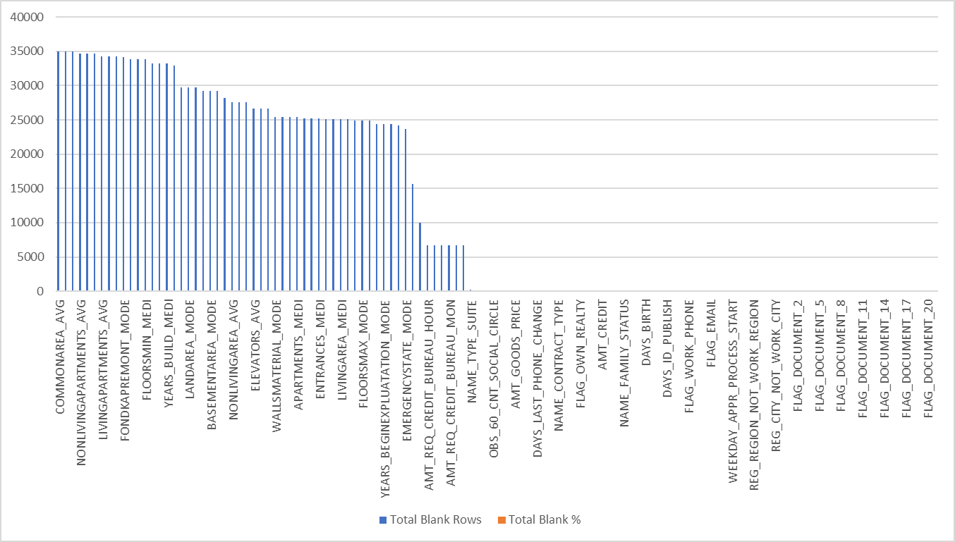
Bar chart for Blank cells as wells for non-blank columns sorted by Highest to Lowest.

Slide 10
Then a Pivot Table is created now to calculate the mean and median and mode of the various fields so that we could work upon replacing the fields with appropriate data so that dataset is not affected and is filled perfectly.

Slide 11
Now we calculated the median of EXT_SOURCE_3 and decided to replace it throughout the blanks of that field. Then we performed the replacement function with the whole column and the blanks were finally replaced with the median of the field. Similarly we worked out with other field eliminating the blank cells.

Slide 12
Then we categorize the occupation type and then we count the number of occupation type in total and observe that the laborers is basically the mode of the occupation type. Thus, we can replace the blanks with laborers so that the data set get stretched to the mode and become consistent.

Slide 13
Previous application dataset cleaning
In this file followed the same process first I have calculated the total number of blank cells using COUNTBLANK formula and then find out the total percentage of blank cells by total rows. There are 50 thousands rows in both the dataset
In the previous application dataset I have removed the columns with more than 50% blank cells.
Also plotted the bar chart for the same showing percentage of null cells in the dataset.
I have attached the table for the same.
Columns | Total Blank Rows | Total Blank %
RATE_INTEREST_PRIMARY | 49834 | 99.67
RATE_INTEREST_PRIVILEGED | 49834 | 99.67
AMT_DOWN_PAYMENT | 25198 | 50.40
RATE_DOWN_PAYMENT | 25198 | 50.40
NAME_TYPE_SUITE | 24243 | 48.49

Slide 14
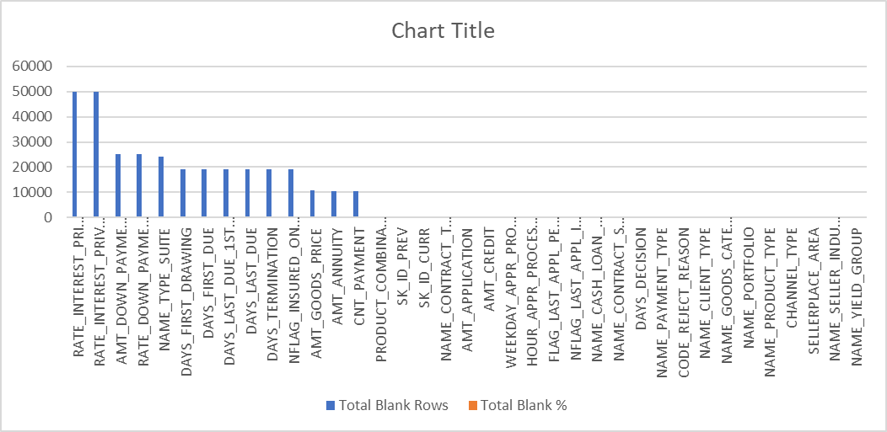
Bar chart for total percent of null cells in the previous app. dataset

Slide 15
Data Analytics task 2
Identify Outliers in the Dataset: Outliers can significantly impact the analysis and distort the results. You need to identify outliers in the loan application dataset.
Task: Detect and identify outliers in the dataset using Excel statistical functions and features, focusing on numerical variables.

Slide 16
Understanding Outliers
An outlier is an observation that lies an abnormal distance from other values in a random sample from a population. In a sense, this definition leaves it up to the analyst (or a consensus process) to decide what will be considered abnormal. Before abnormal observations can be singled out, it is necessary to characterize normal observations.

Slide 17
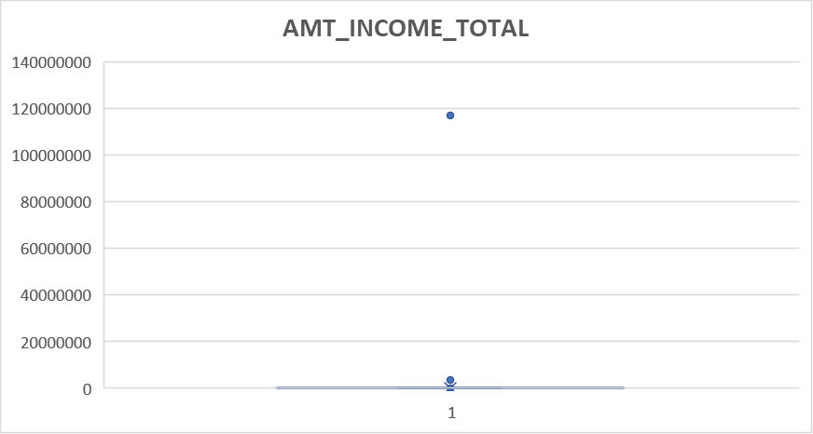
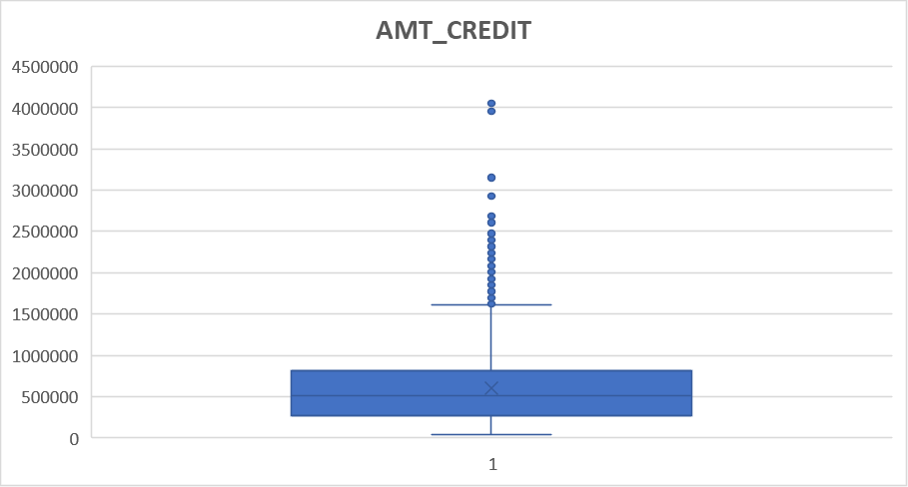
Outliers from Application Dataset
AMT_INCOME_TOTAL and AMT_CREDIT Outlier

Slide 18
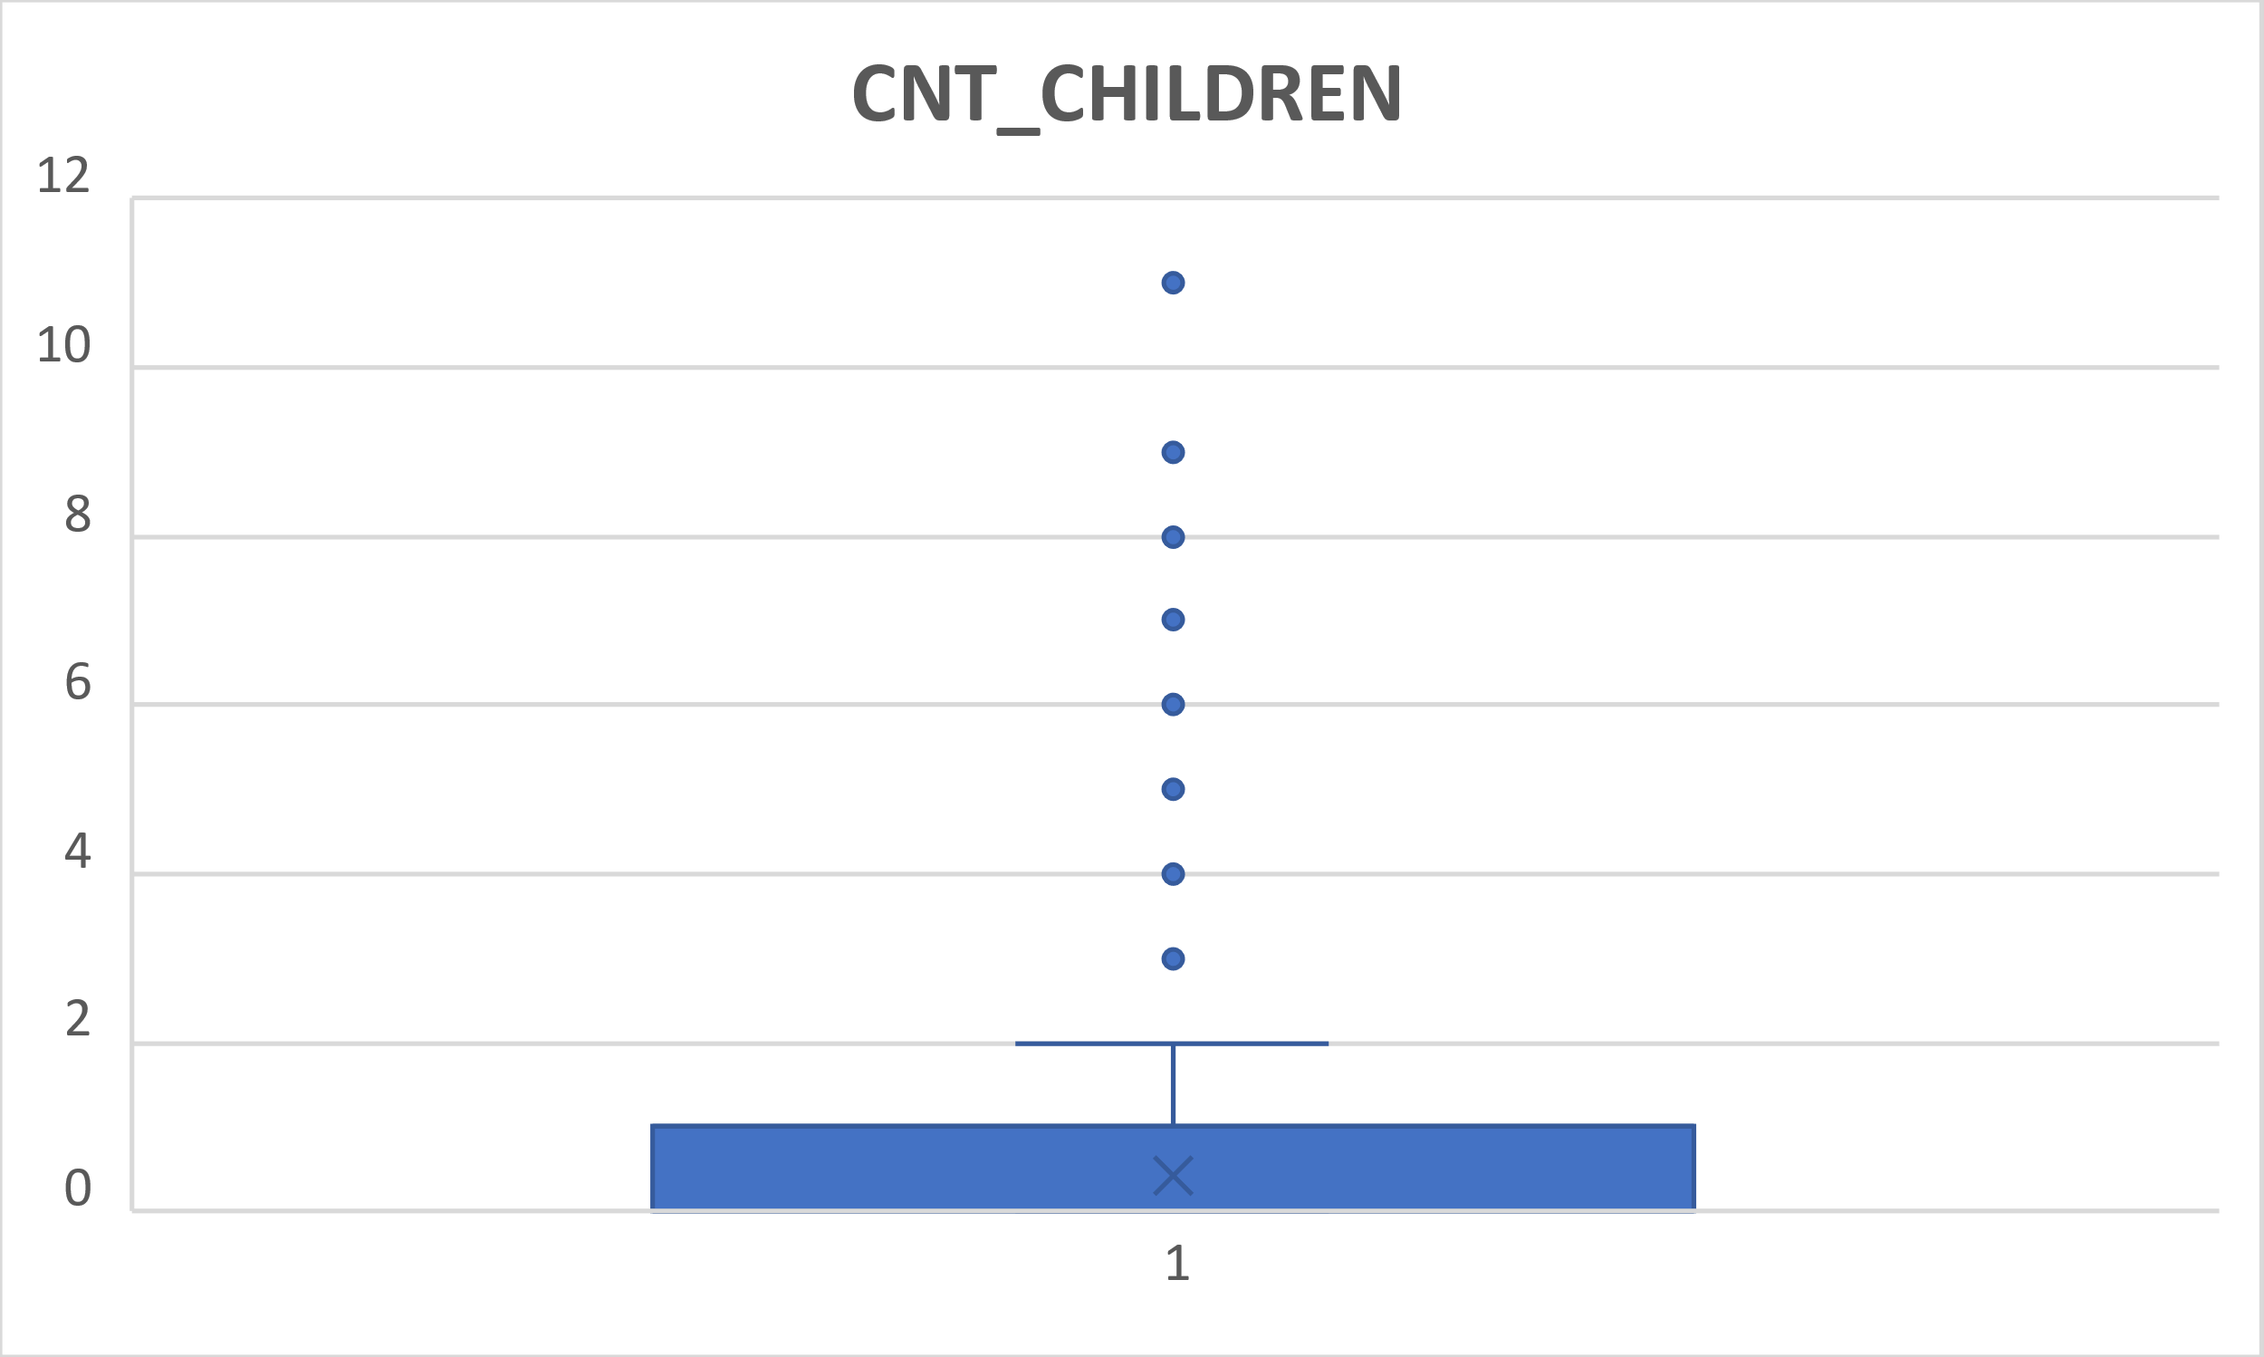
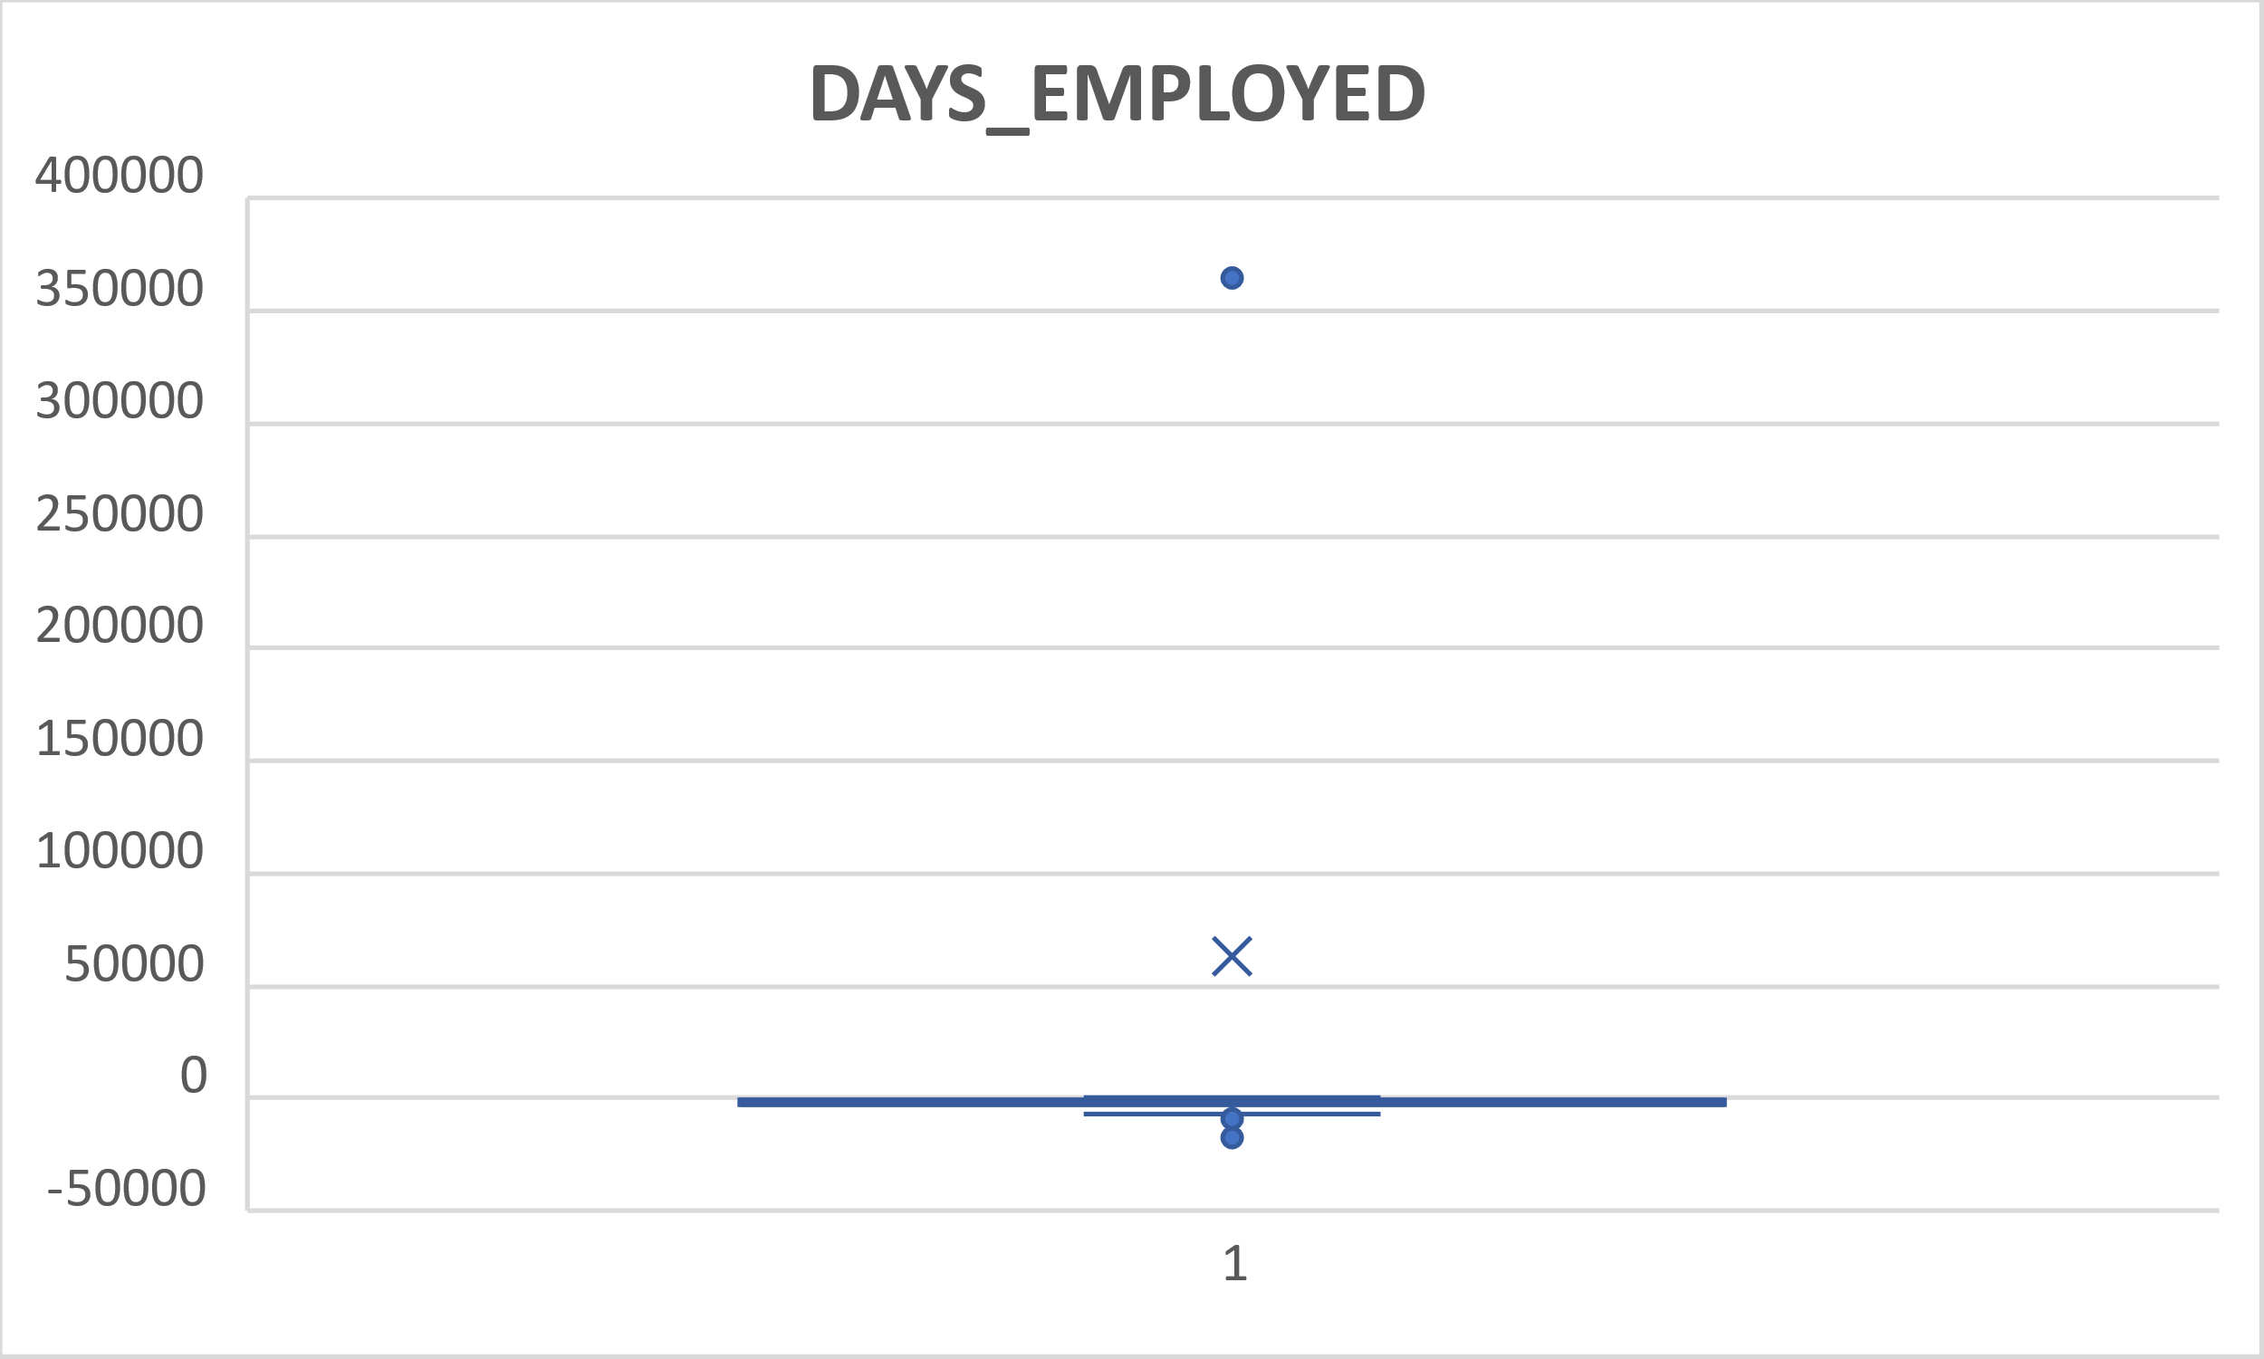
Outliers from Application Dataset
CNT_CHILDREN and DAYS_EMPLOYED Outlier

Slide 19
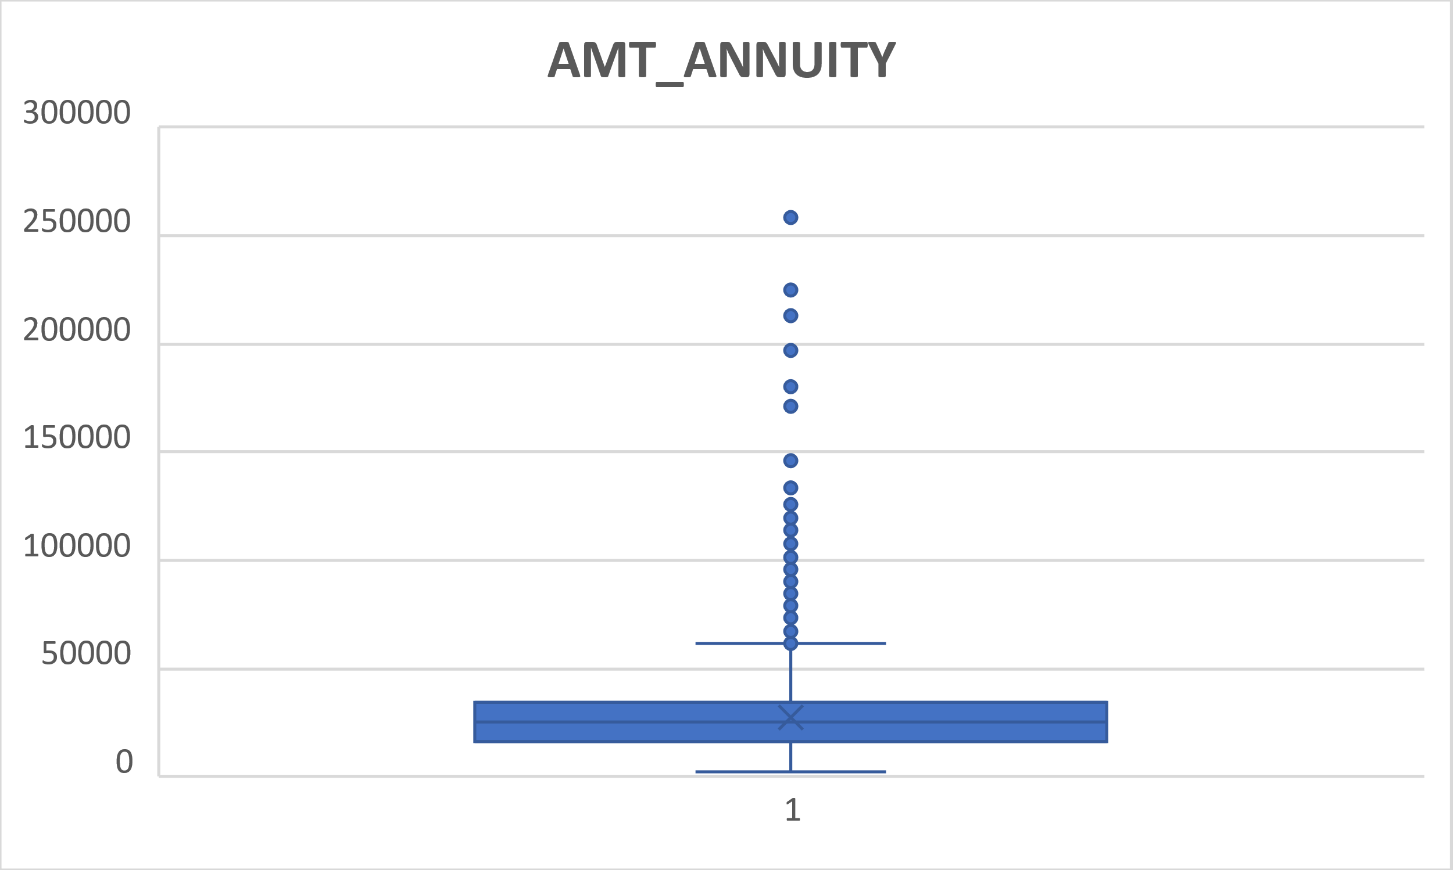
Outliers from Application Dataset
AMT_ANNUITY Outlier

Slide 20
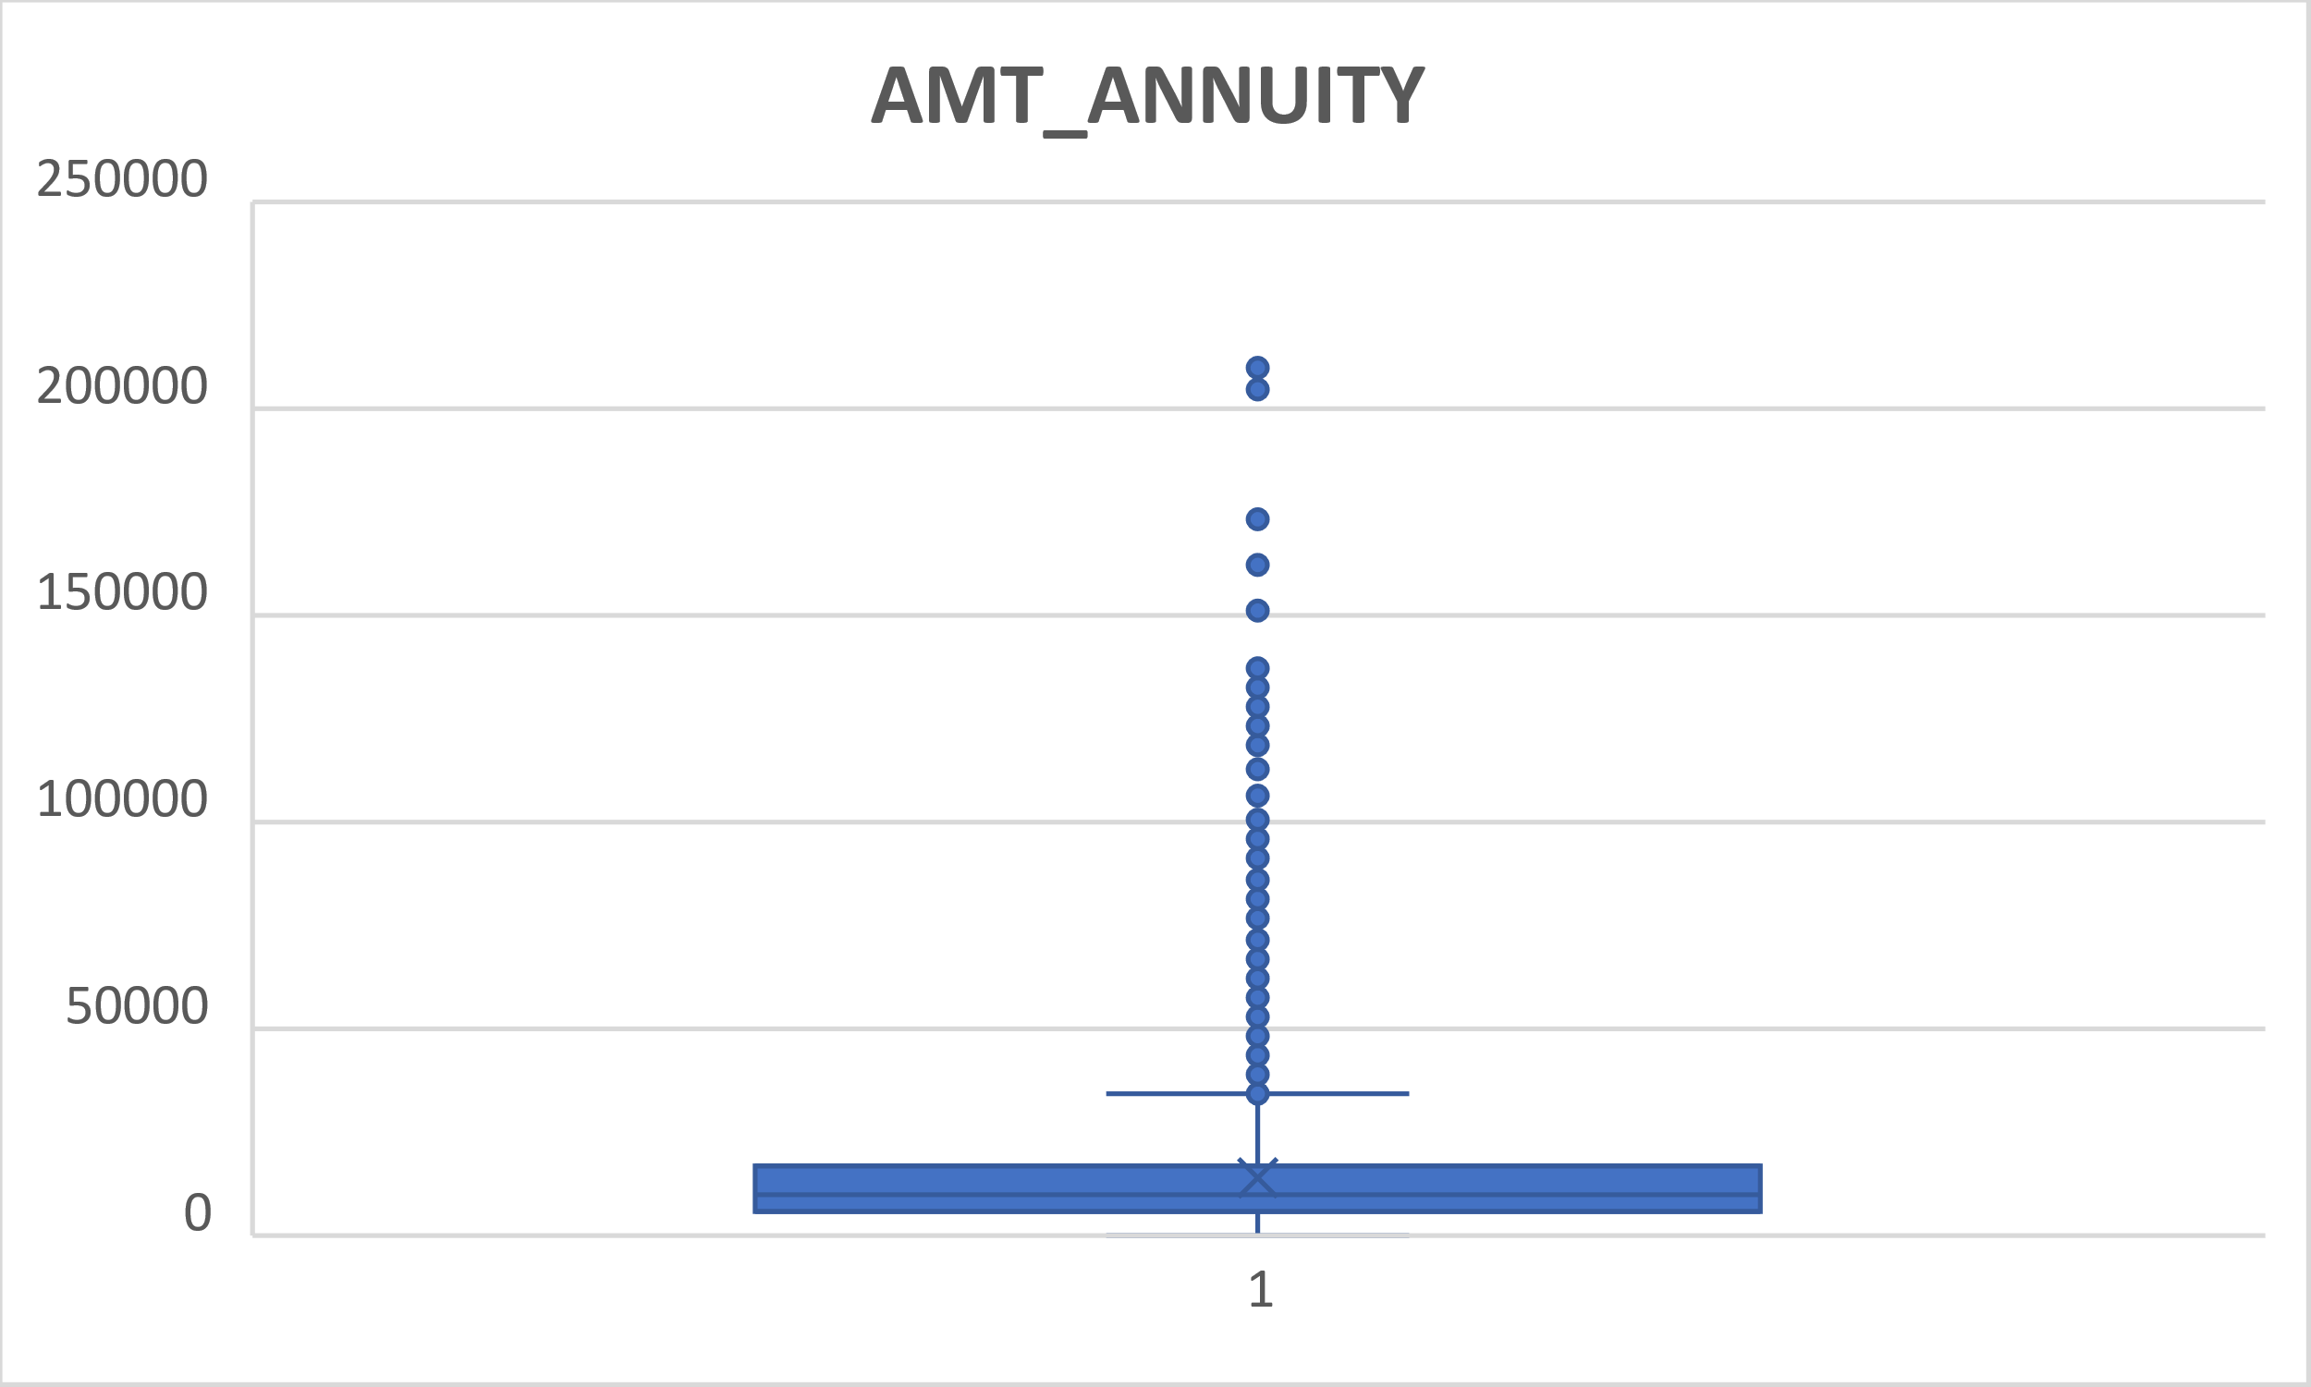
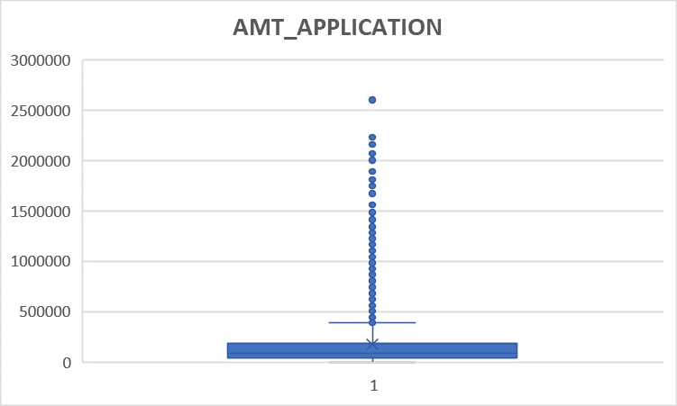
Outliers from Previous Application Dataset
AMT_ANNUITY Outlier and AMT_APPLICATION

Slide 21
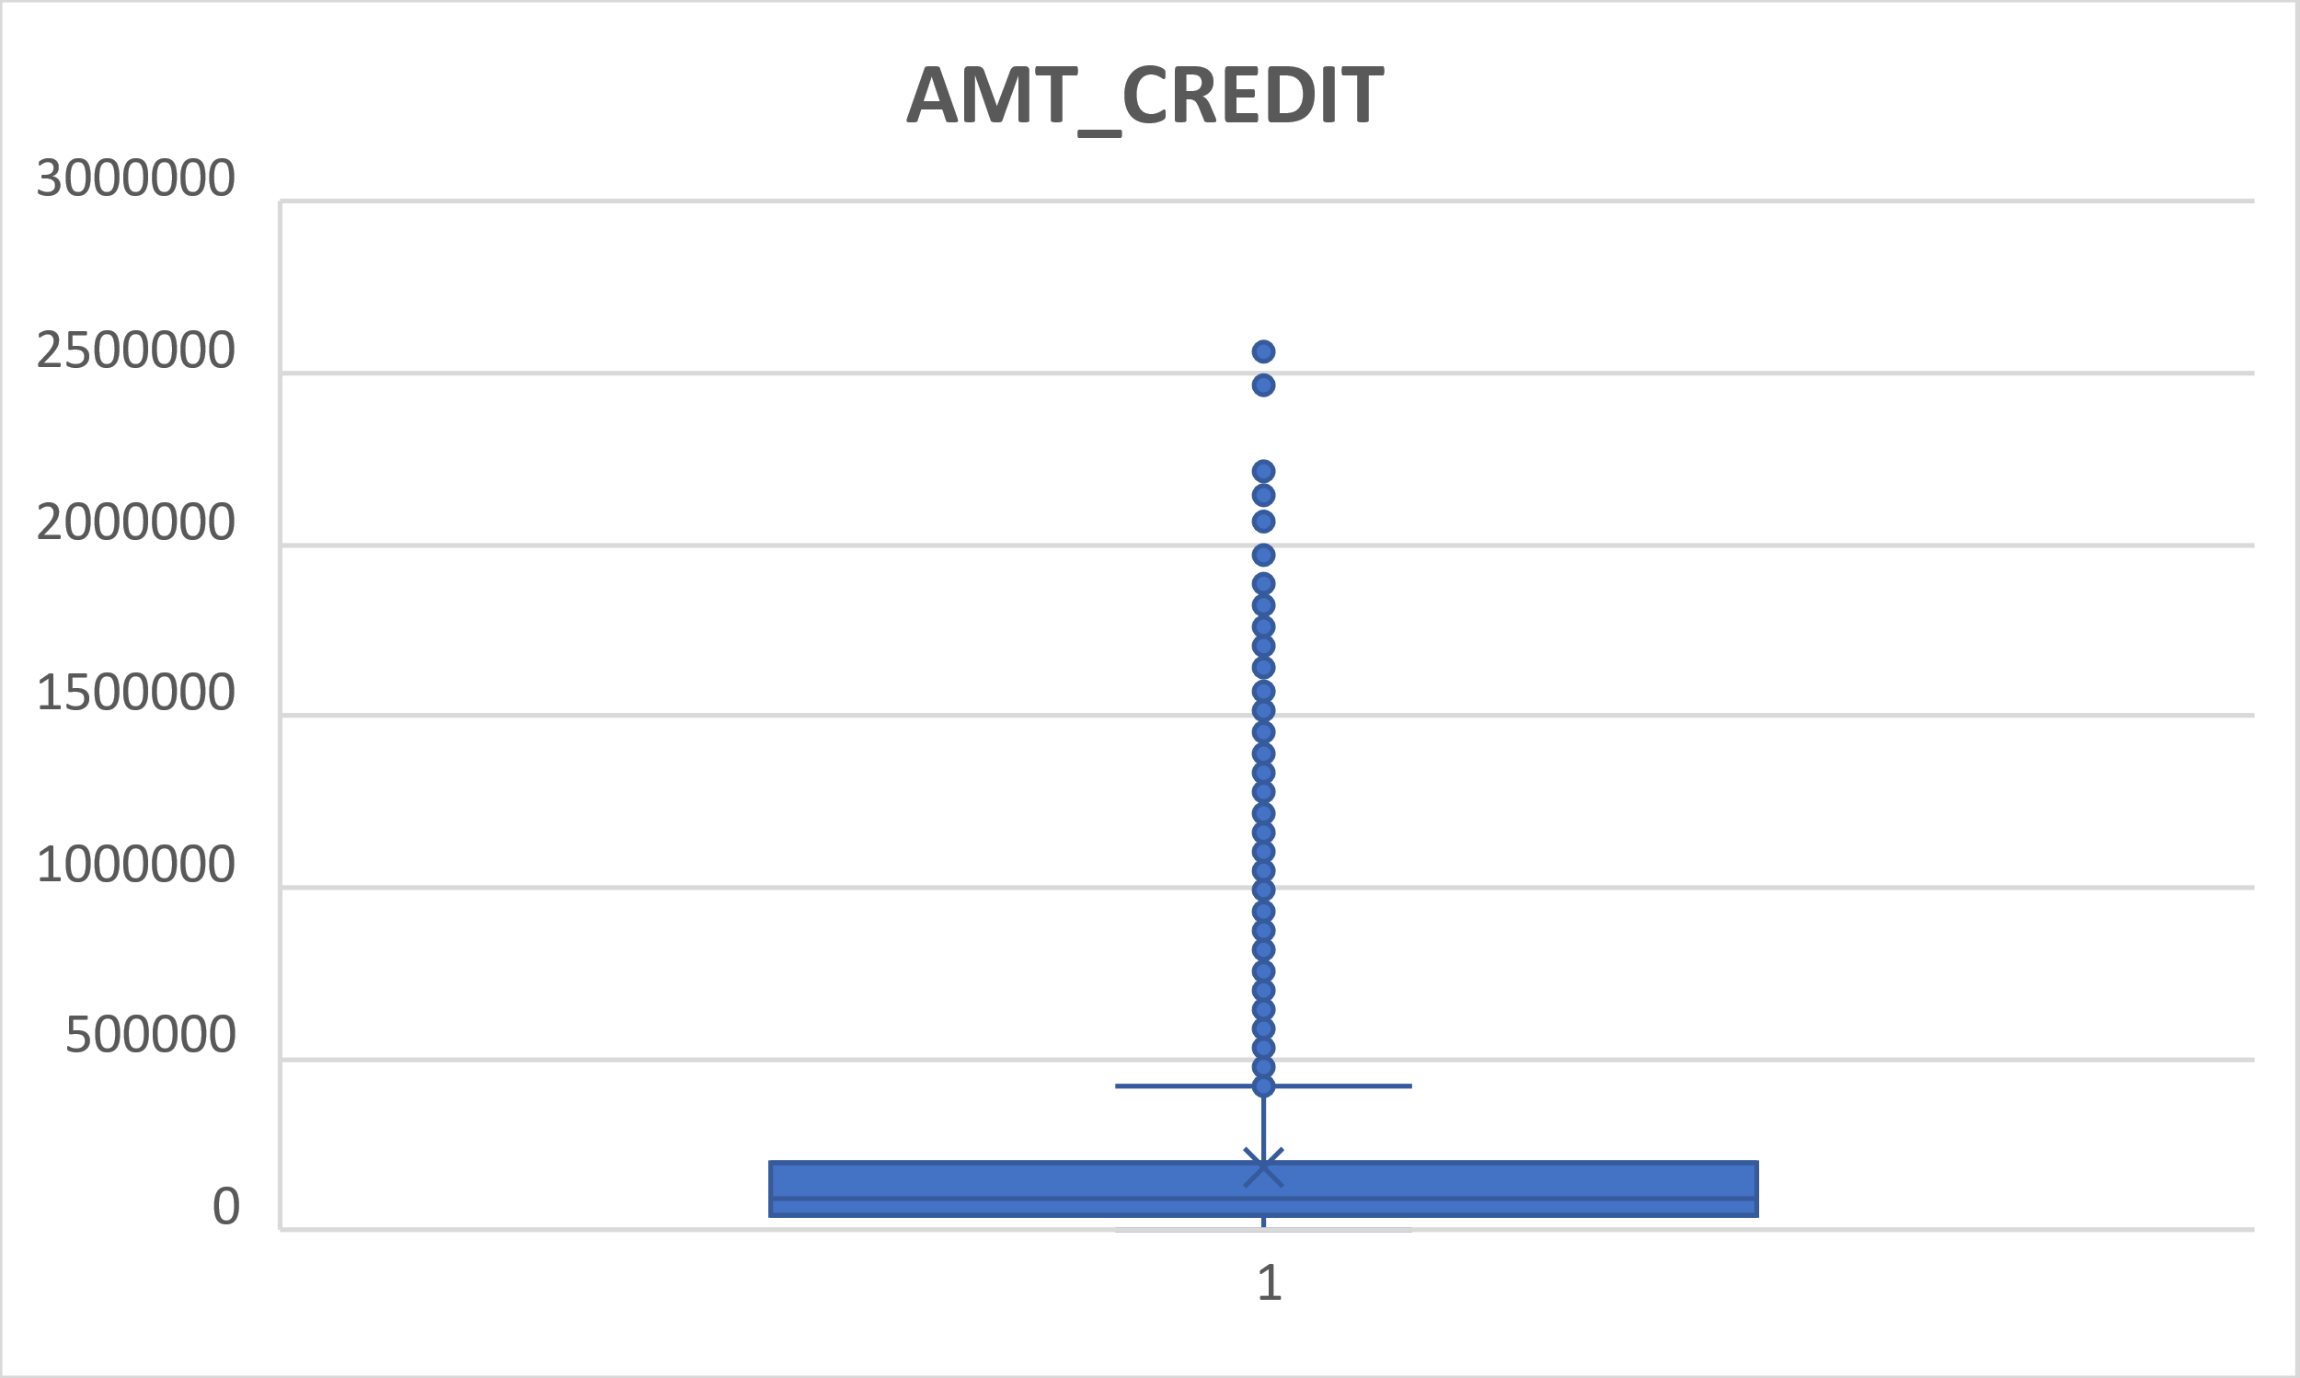
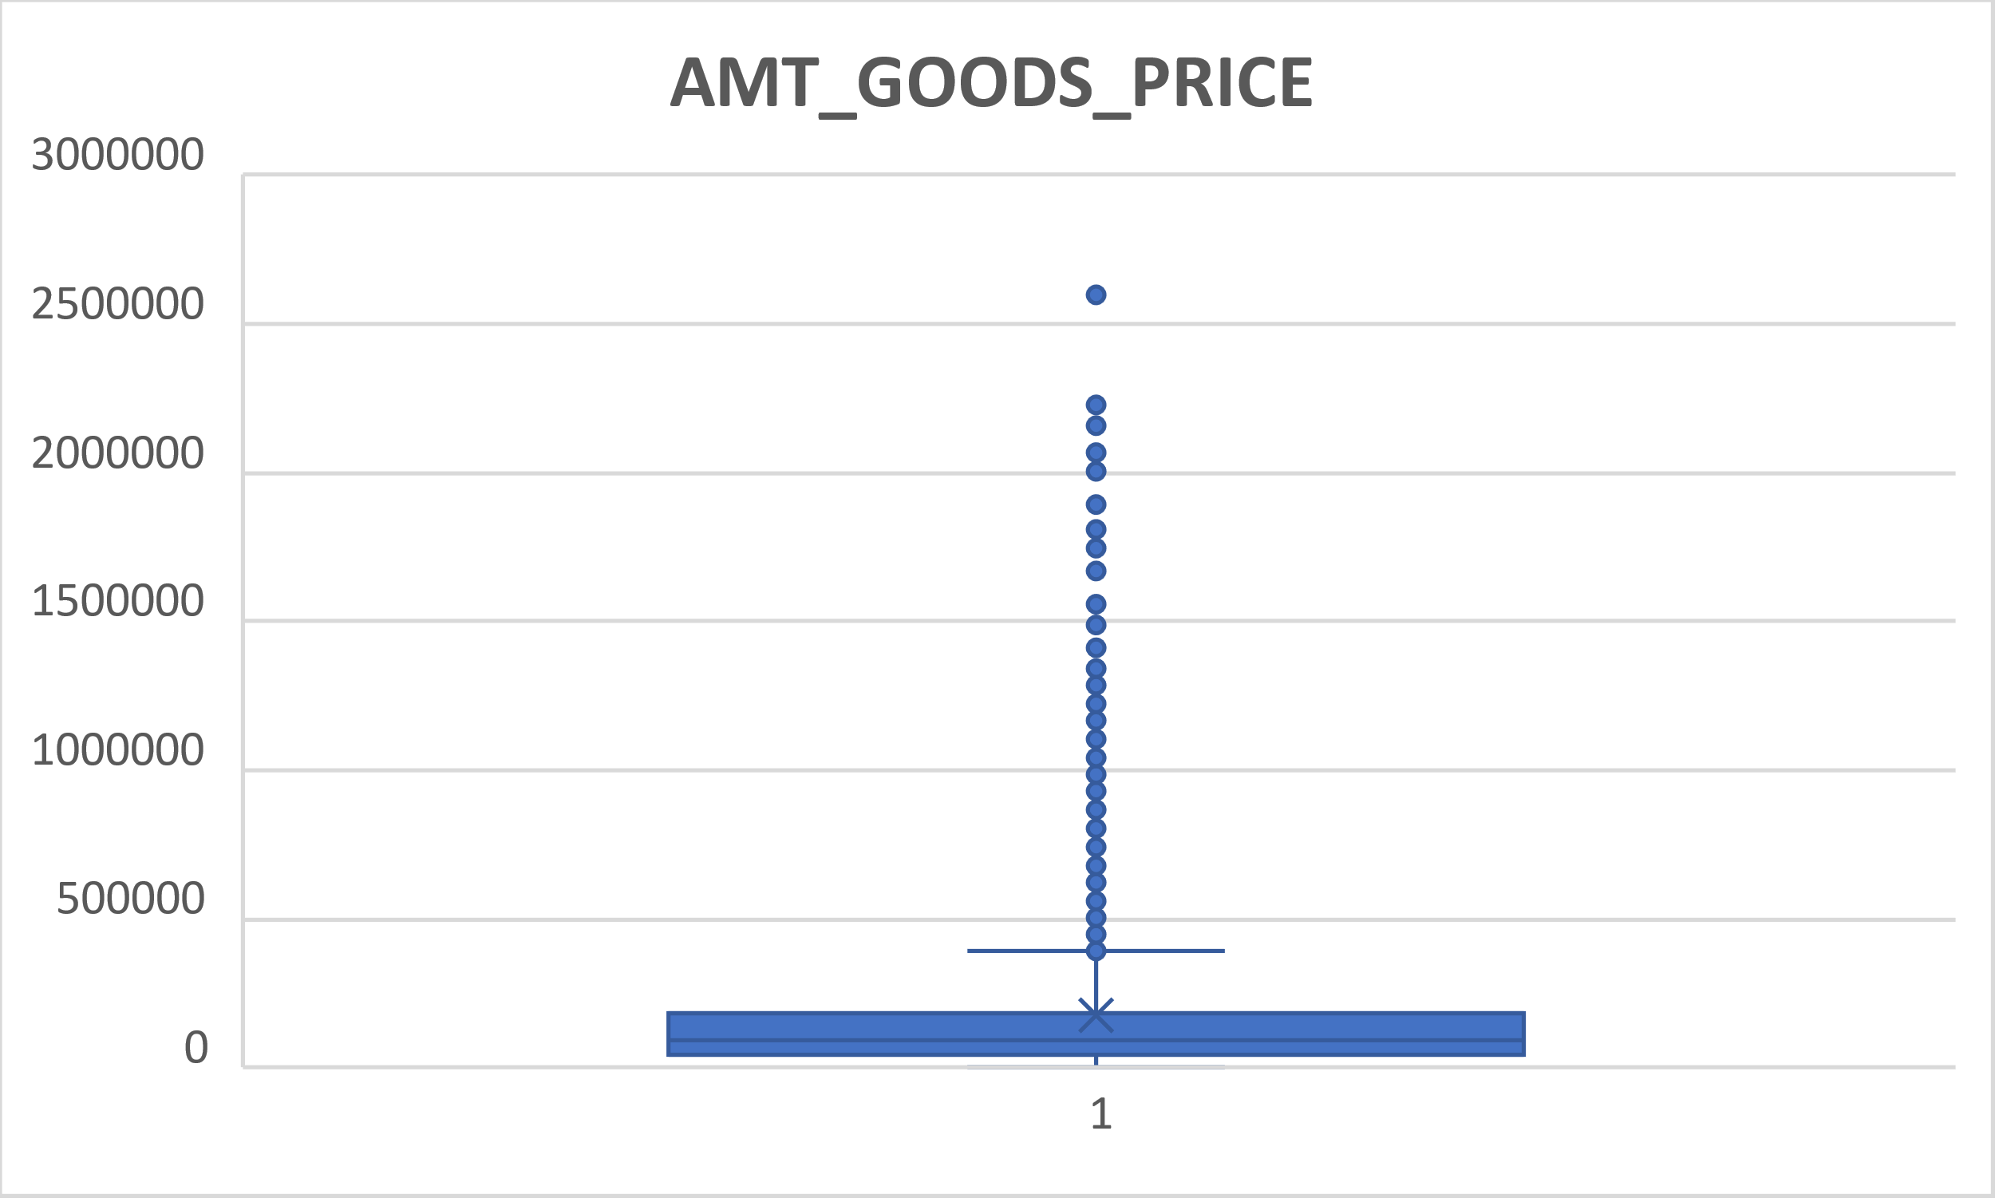
Outliers from Previous Application Dataset
AMT_CREDIT Outlier and AMT_GOODS_PRICE outlier

Slide 22
Now as we identified the outliers, we decided to get the values replaced so as to get the dataset settled and keep the median mode and mean of the dataset consistent.

Slide 23
Data Analytics task 3
Analyze Data Imbalance: Data imbalance can affect the accuracy of the analysis, especially for binary classification problems. Understanding the data distribution is crucial for building reliable models.
Task: Determine if there is data imbalance in the loan application dataset and calculate the ratio of data imbalance using Excel functions.

Slide 24
Data Imbalance in Application Dataset
We have calculated the data imbalance in our dataset with TARGET variable.
There are two values in target columns 1 and 0 , 1 means the client with the payment difficulties in repaying their loan and 0 means all other cases.
A pivot table of the TARGET feature was created and then the counts of both the values(0 and 1) were calculated followed by the Pie-chart.
Out of 49999 values, only 4026 values are 1 and others are 0.

Slide 25
Data Imbalance in Application Dataset
By seeing the ratio of the imbalance in the dataset of target analysis, It is not a suitable field to be used as a representative. Thus we chose
Name Family Status as the representative field now.
Now we take Name Family Status as the dataset and construct the bar graph and pie chart.

Slide 26
Data Analytics task 4
Perform Univariate, Segmented Univariate, and Bivariate Analysis: To gain insights into the driving factors of loan default, it is important to conduct various analyses on consumer and loan attributes.
Task: Perform univariate analysis to understand the distribution of individual variables, segmented univariate analysis to compare variable distributions for different scenarios, and bivariate analysis to explore relationships between variables and the target variable using Excel functions and features.

Slide 27
Understanding Uni-Variate, Bi-Variate and Segmented Univariate analysis
Univariate analysis is the simplest form of analyzing data. “Uni” means “one”, so in other words your data has only one variable. It doesn’t deal with causes or relationships (unlike regression ) and it’s major purpose is to describe; It takes data, summarizes that data and finds patterns in the data.
The term bivariate analysis refers to the analysis of two variables. You can remember this because the prefix “bi” means “two.” The purpose of bivariate analysis is to understand the relationship between two variables.
Segmented univariate analysis is a type of analysis where data is analyzed separately for different segments or subgroups within the data1. This type of analysis is useful when there are significant differences in the data across different segments or when there is a need to compare the performance of different subgroups within the data1. Segmented univariate analysis involves dividing the data into segments based on some criteria or characteristic, such as demographics, geography, time period, or product category. Once the data is segmented, univariate analysis is performed on each segment separately to identify the unique characteristics and patterns within each segment.

Slide 28
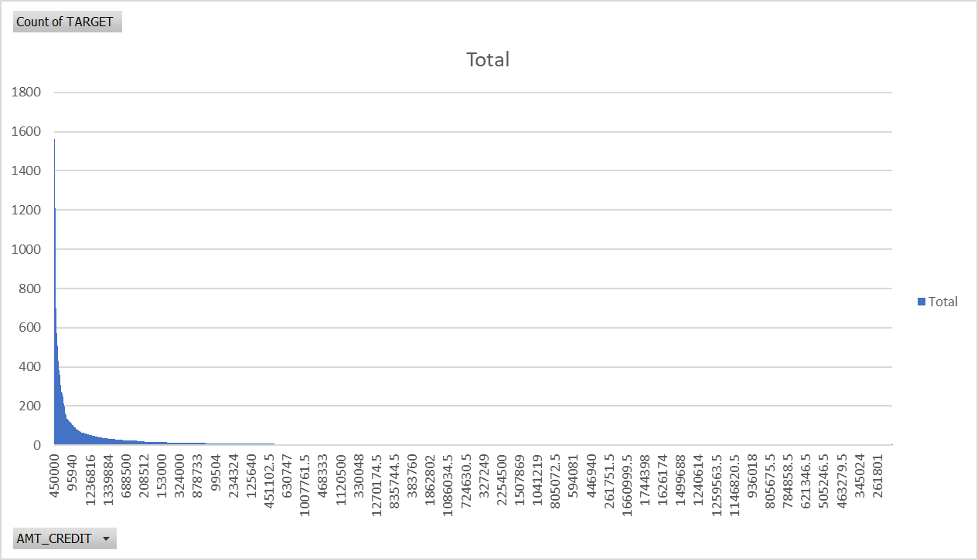
Univariate Analysis

Slide 29
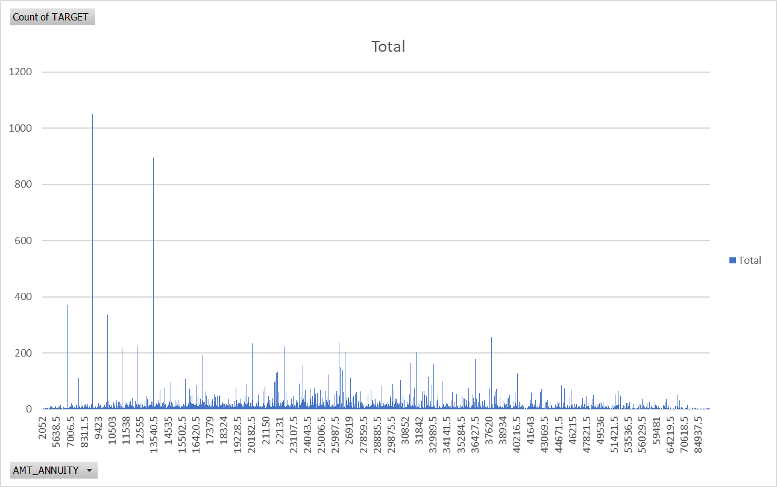
Univariate Analysis

Slide 30
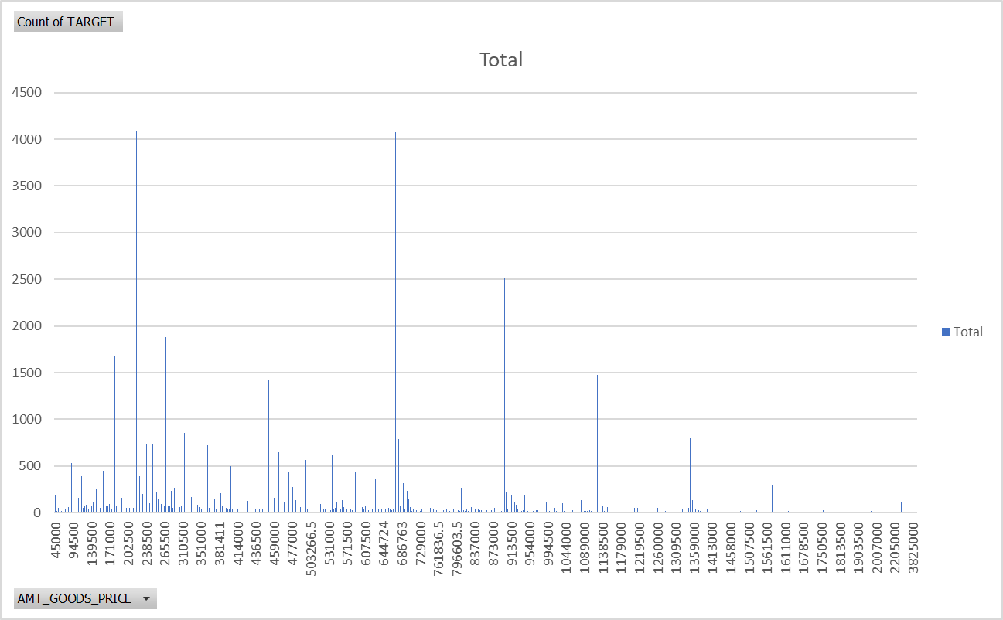
Univariate Analysis

Slide 31
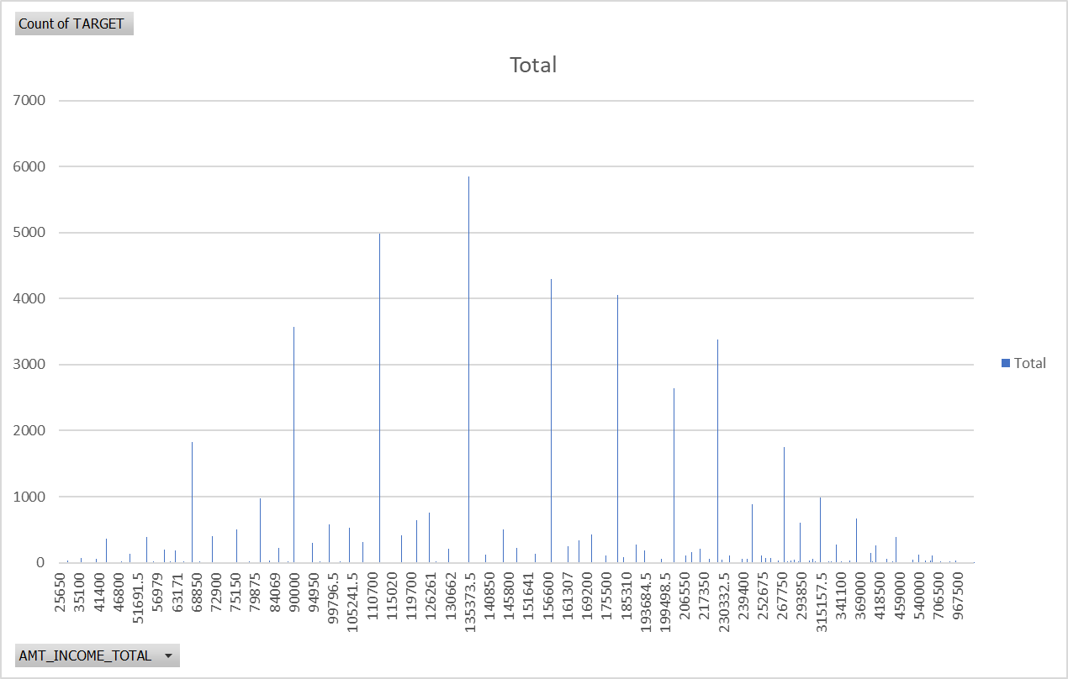
Univariate Analysis

Slide 32
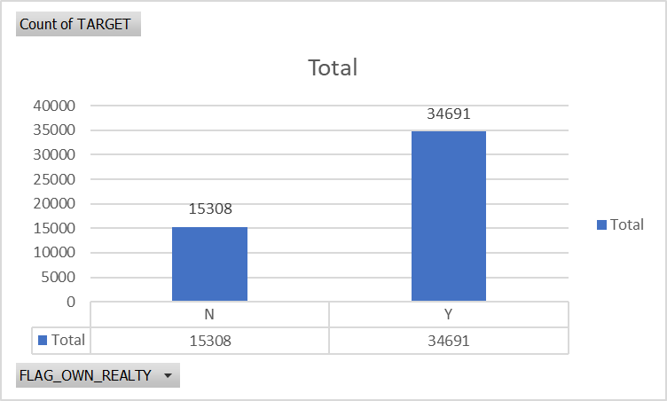
Univariate Analysis
This is the detail of the clients if he owns a house or not
Row Labels | Count of TARGET
N | 15308
Y | 34691
Grand Total | 49999

Slide 33
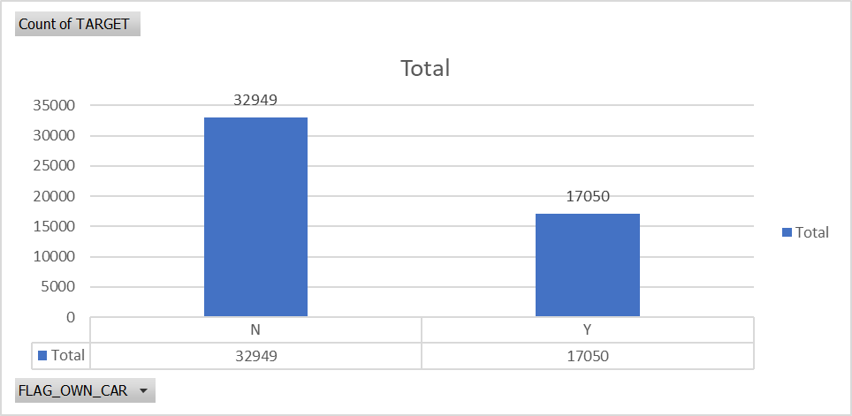
Univariate Analysis
This is the detail of the clients if he owns a car or not we can see that major of the clients don’t owns a car
Row Labels | Count of TARGET
N | 32949
Y | 17050
Grand Total | 49999

Slide 34
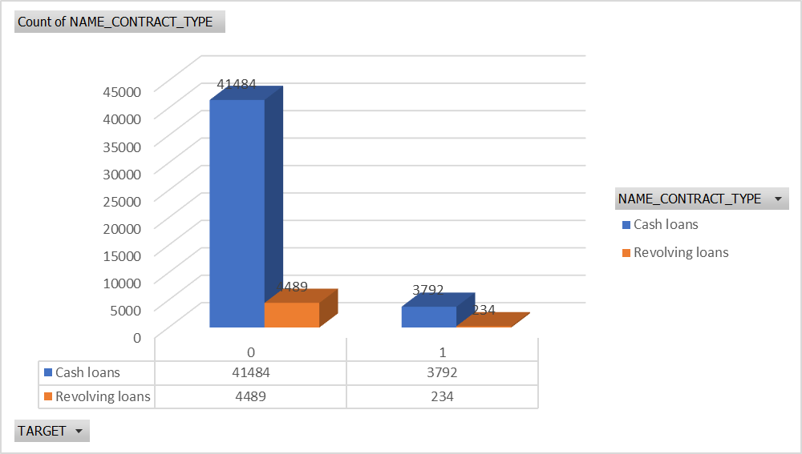
Bivariate Analysis
Count of NAME_CONTRACT_TYPE | Column Labels
Row Labels | Cash loans | Revolving loans | Grand Total
0 | 41484 | 4489 | 45973
1 | 3792 | 234 | 4026
Grand Total | 45276 | 4723 | 49999
Identification if loan is either cash or revolving with target variable, this understands that the defaulters to paying loans by contract type

Slide 35
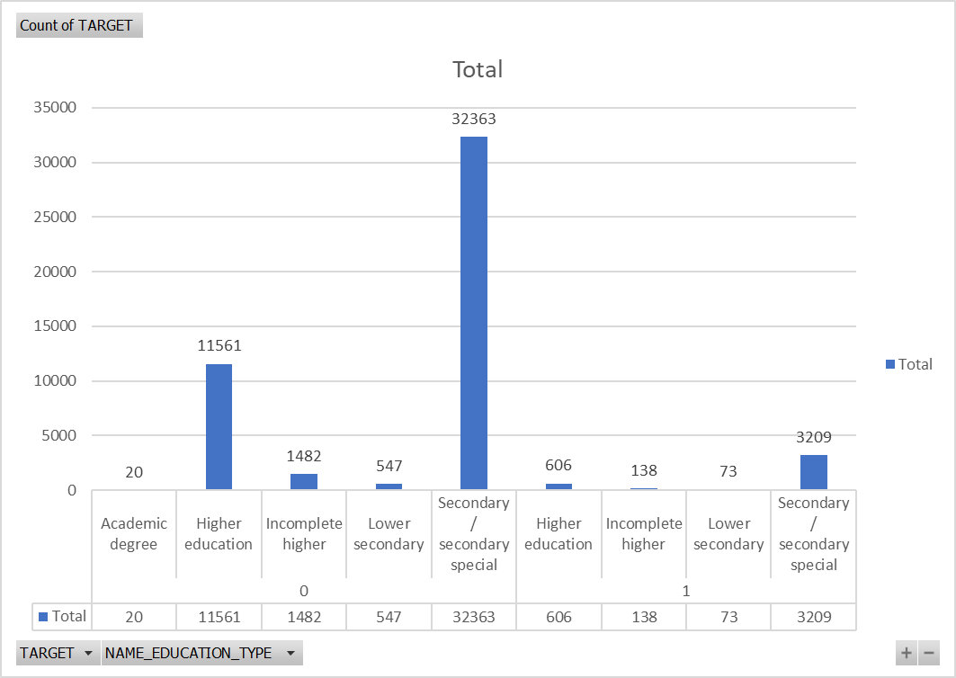
Row Labels | Count of TARGET
0 | 45973
Academic degree | 20
Higher education | 11561
Incomplete higher | 1482
Lower secondary | 547
Secondary / secondary special | 32363
1 | 4026
Higher education | 606
Incomplete higher | 138
Lower secondary | 73
Secondary / secondary special | 3209
Grand Total | 49999
Bivariate Analysis
Analysis on education type of defaulters.
We can see that clients from education level Secondary/Secondary special are highest and this from 0 Target variable which means they are not getting any payment difficulty in paying their loan on time.

Slide 36
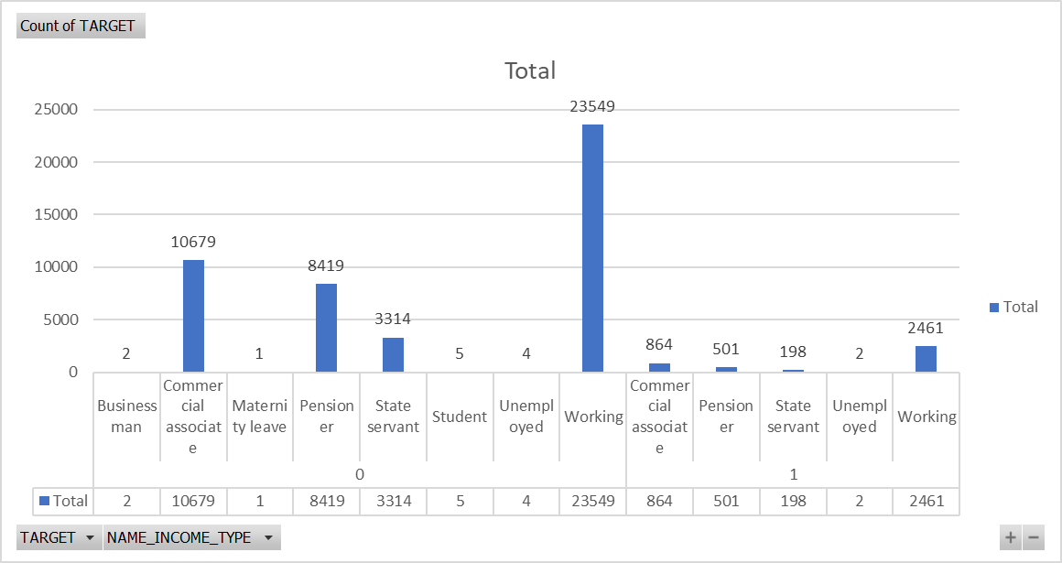
Row Labels | Count of TARGET
0 | 45973
Businessman | 2
Commercial associate | 10679
Maternity leave | 1
Pensioner | 8419
State servant | 3314
Student | 5
Unemployed | 4
Working | 23549
1 | 4026
Commercial associate | 864
Pensioner | 501
State servant | 198
Unemployed | 2
Working | 2461
Grand Total | 49999
Bivariate Analysis
Analysis by Income type. This is the details of the profession of the clients. On analysis we can see that the clients from profession type Working are highest.

Slide 37
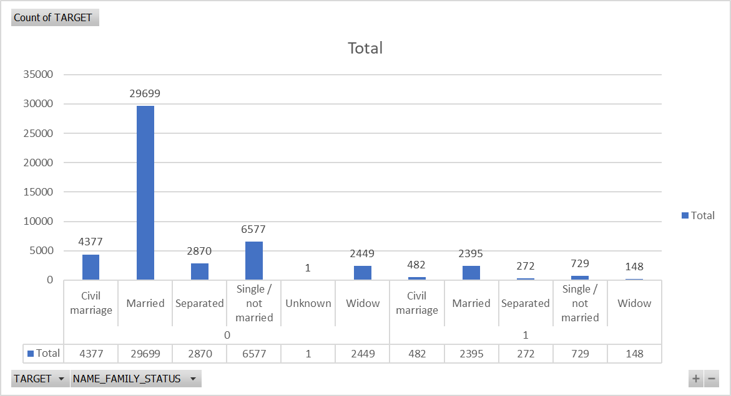
Row Labels | Count of TARGET
0 | 45973
Civil marriage | 4377
Married | 29699
Separated | 2870
Single / not married | 6577
Unknown | 1
Widow | 2449
1 | 4026
Civil marriage | 482
Married | 2395
Separated | 272
Single / not married | 729
Widow | 148
Grand Total | 49999
Bivariate Analysis
In this chart we can see that clients are mostly from Married category. They are highest loan applicants. Clients from non defaulters category are more than from defaulters category.
We can understand that from defaulters category there highest number of married clients which faces payment difficulty.

Slide 38
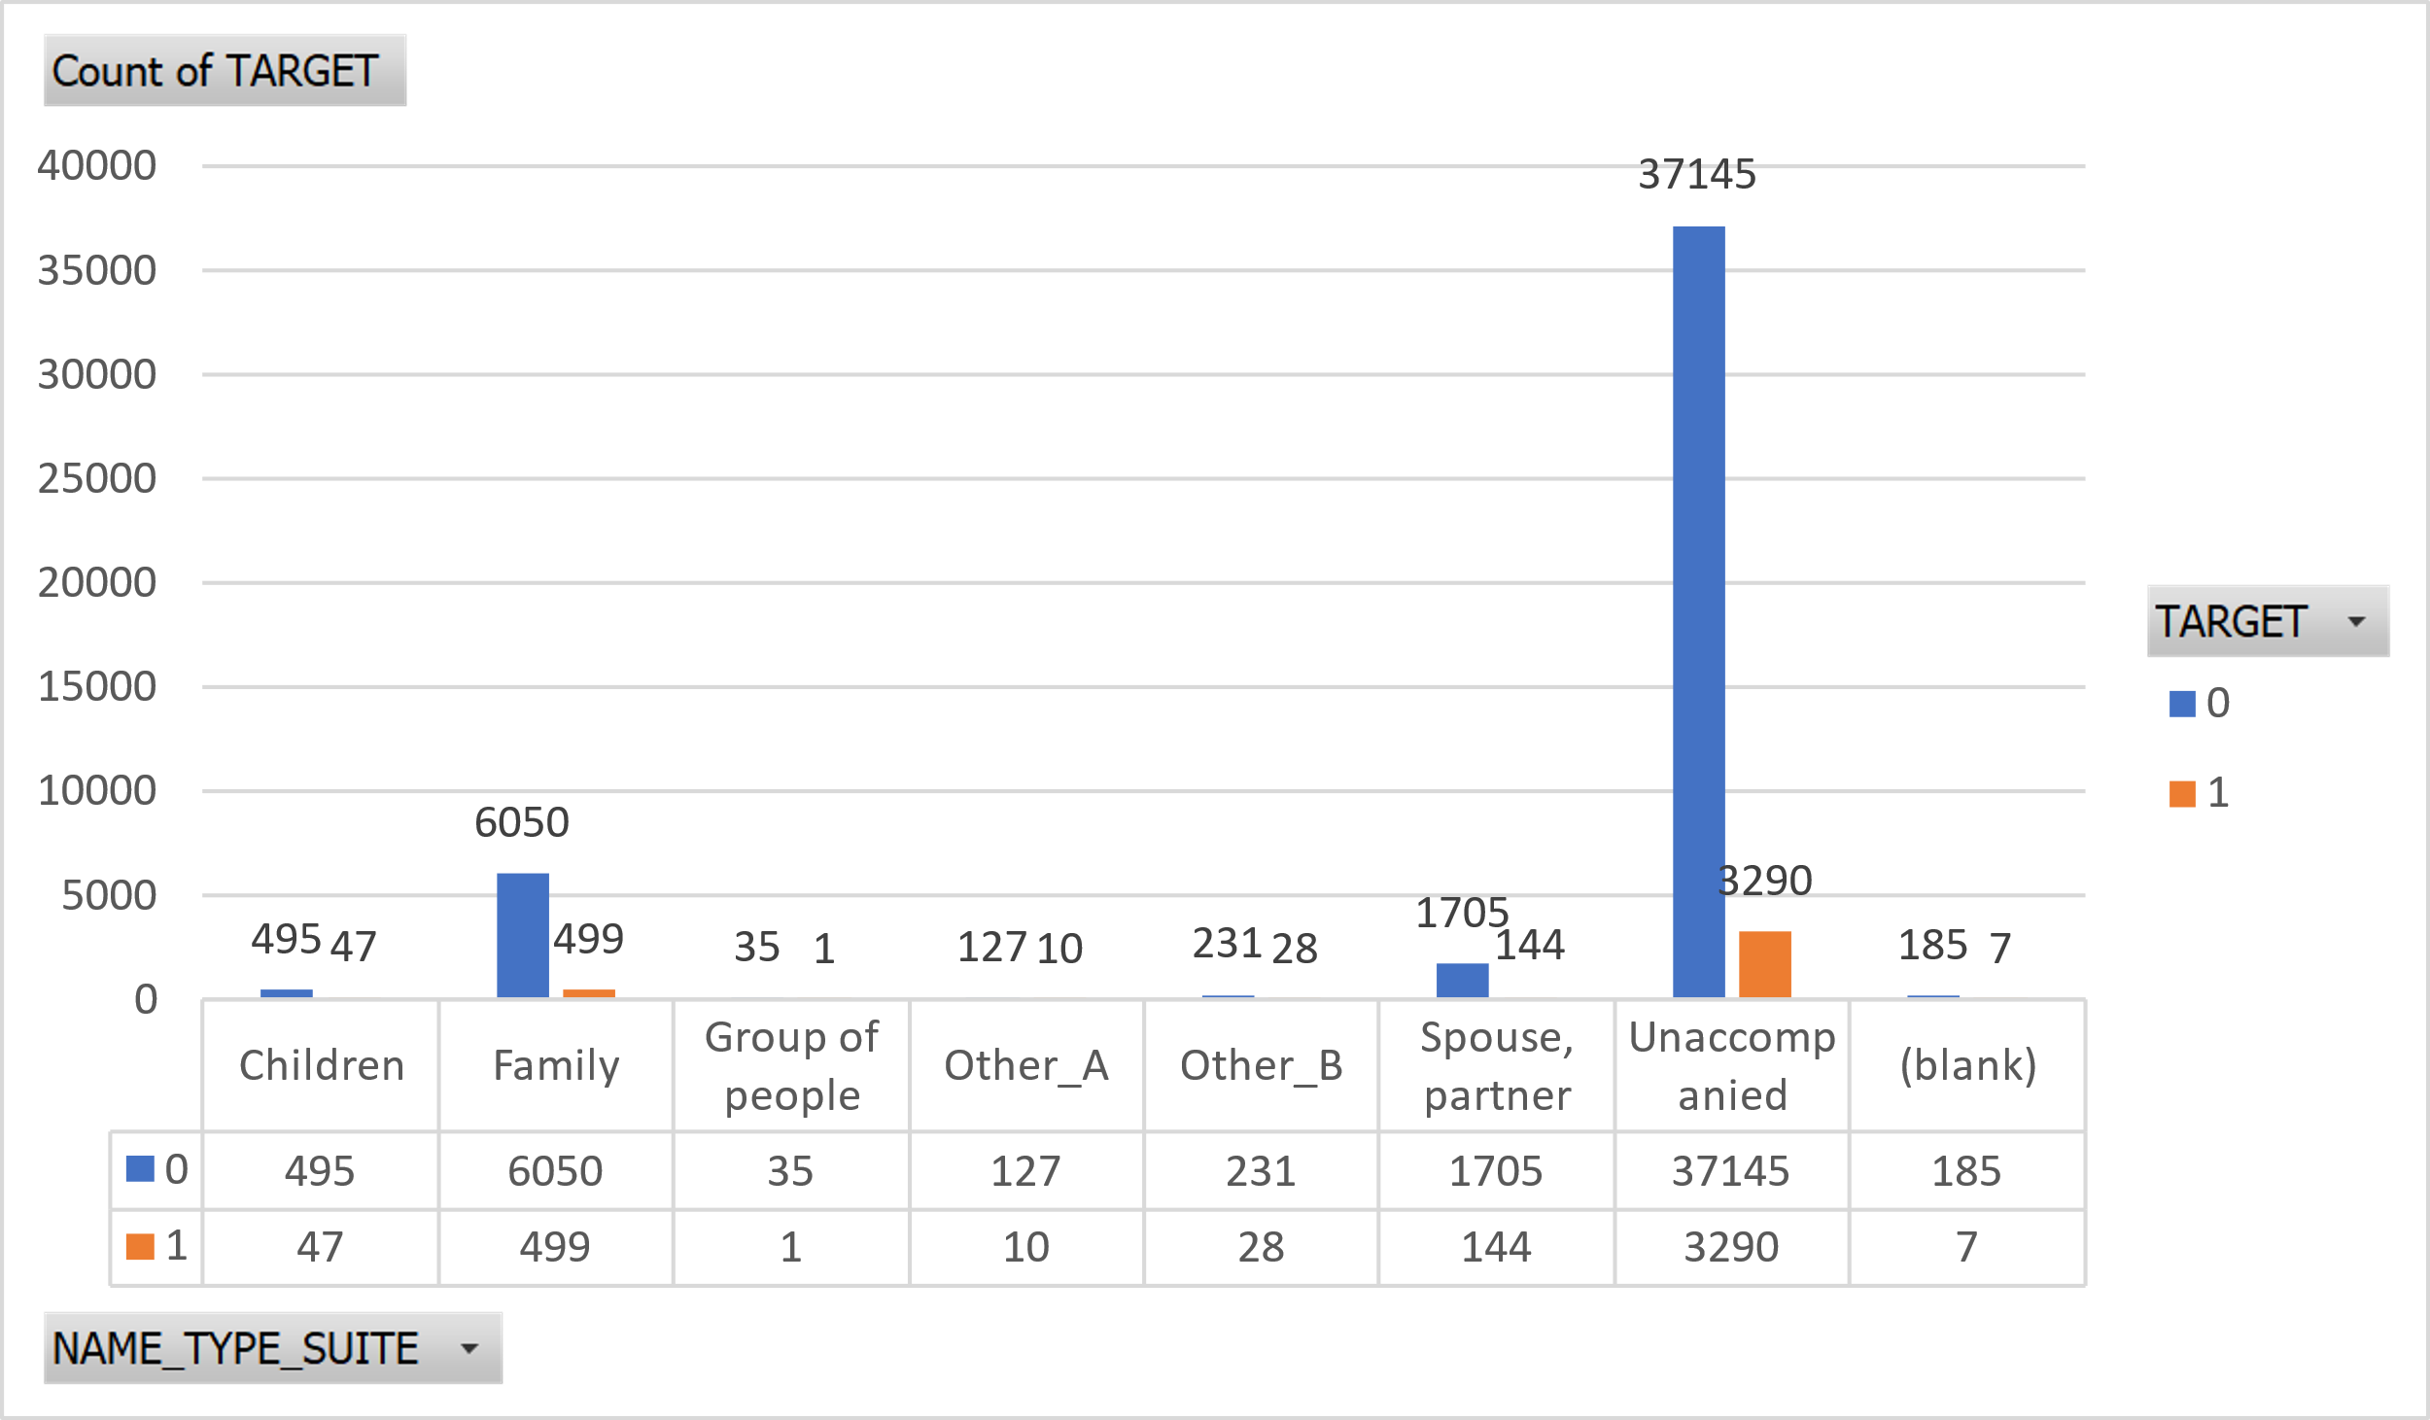
Count of TARGET | Column Labels
Row Labels | 0 | 1 | Grand Total
Children | 495 | 47 | 542
Family | 6050 | 499 | 6549
Group of people | 35 | 1 | 36
Other_A | 127 | 10 | 137
Other_B | 231 | 28 | 259
Spouse, partner | 1705 | 144 | 1849
Unaccompanied | 37145 | 3290 | 40435
(blank) | 185 | 7 | 192
Grand Total | 45973 | 4026 | 49999
Bivariate Analysis
This is the details of the client who was accompanied with.
From chart most of the clients are accompanied while others clients are being accompanied by family members and then by spouse or partner.

Slide 39
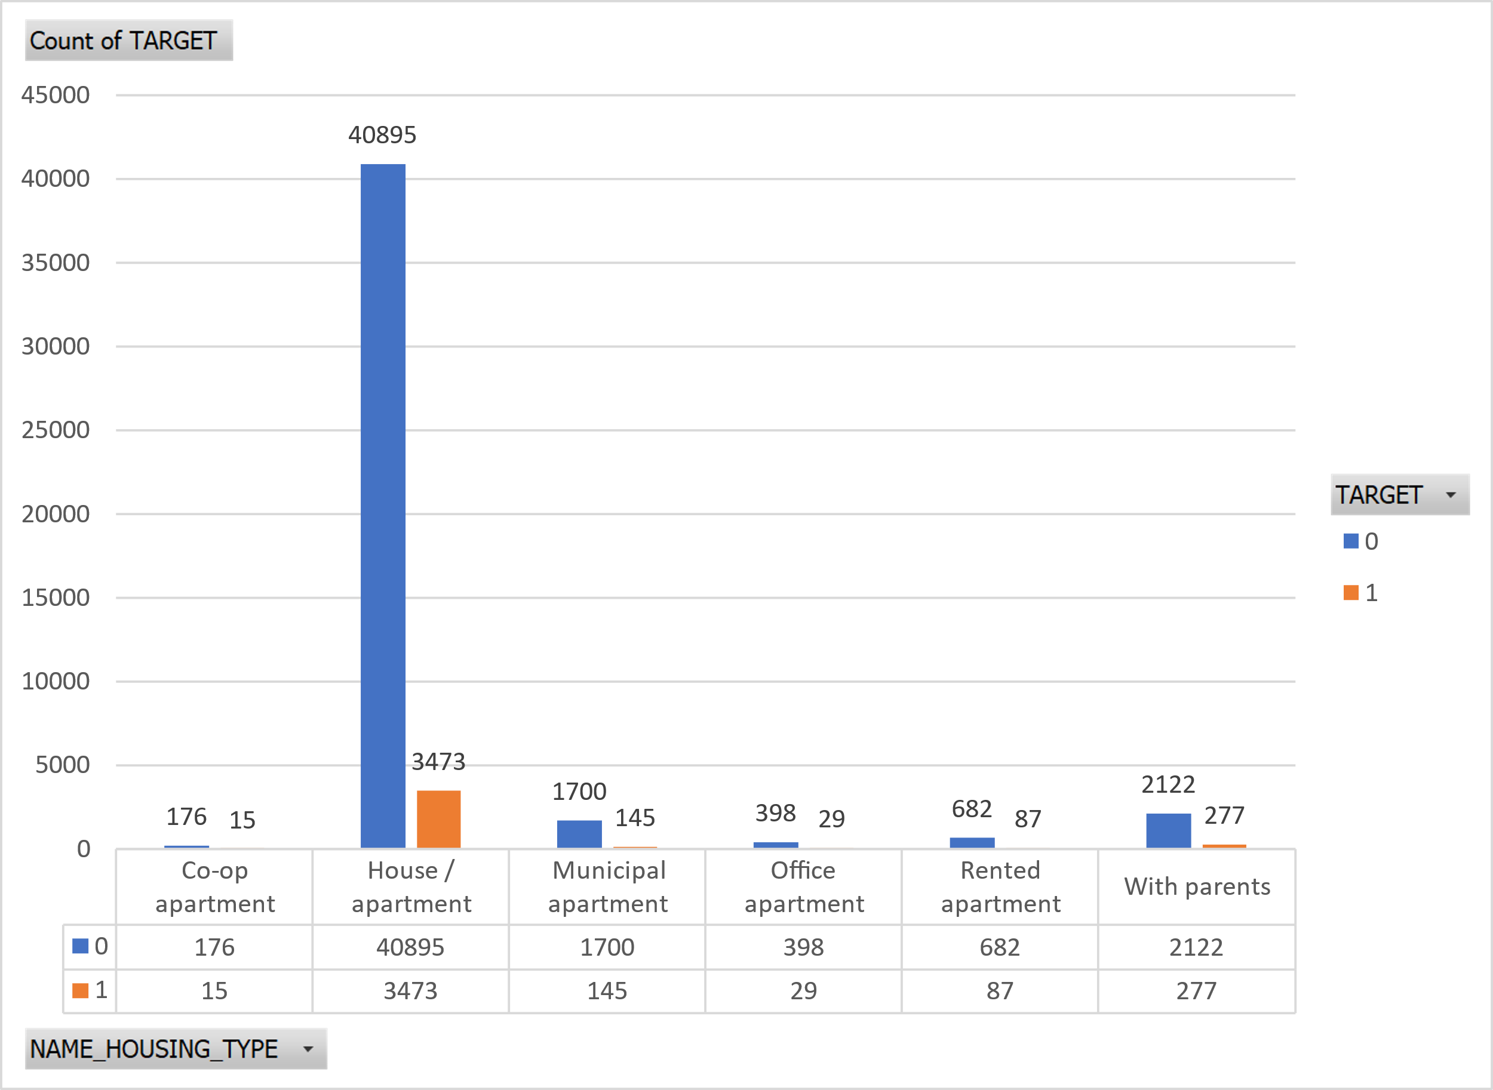
Count of TARGET | Column Labels
Row Labels | 0 | 1 | Grand Total
Co-op apartment | 176 | 15 | 191
House / apartment | 40895 | 3473 | 44368
Municipal apartment | 1700 | 145 | 1845
Office apartment | 398 | 29 | 427
Rented apartment | 682 | 87 | 769
With parents | 2122 | 277 | 2399
Grand Total | 45973 | 4026 | 49999
Bivariate Analysis
In this analysis we can see that people from clients are mainly from defaulters category owns House apartments.

Slide 40
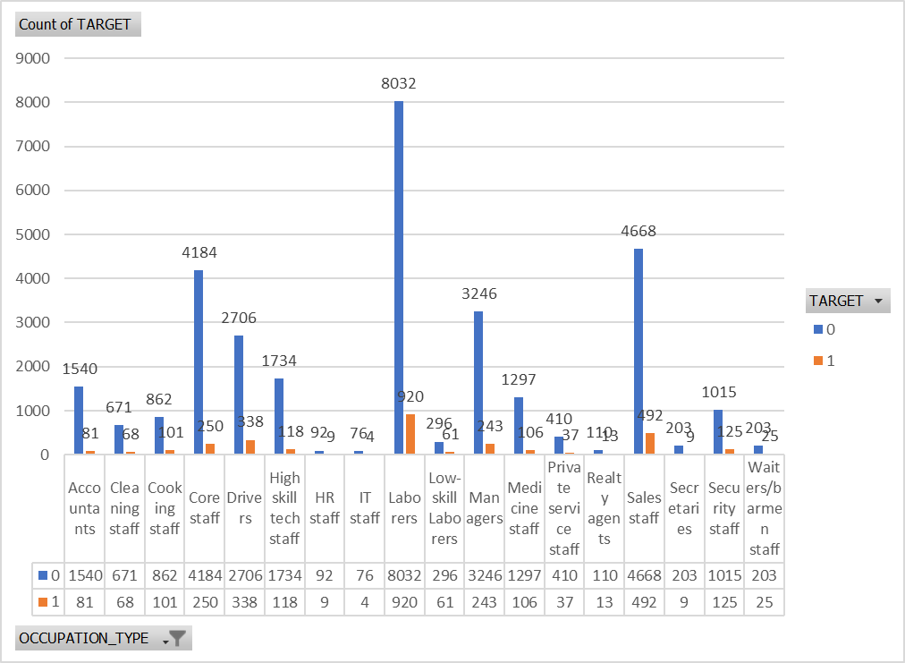
Bivariate Analysis
Analysis based on Occupation Type of Clients
Count of TARGET | Column Labels
Row Labels | 0 | 1 | Grand Total
Accountants | 1540 | 81 | 1621
Cleaning staff | 671 | 68 | 739
Cooking staff | 862 | 101 | 963
Core staff | 4184 | 250 | 4434
Drivers | 2706 | 338 | 3044
High skill tech staff | 1734 | 118 | 1852
HR staff | 92 | 9 | 101
IT staff | 76 | 4 | 80
Laborers | 8032 | 920 | 8952
Low-skill Laborers | 296 | 61 | 357
Managers | 3246 | 243 | 3489
Medicine staff | 1297 | 106 | 1403
Private service staff | 410 | 37 | 447
Realty agents | 110 | 13 | 123
Sales staff | 4668 | 492 | 5160
Secretaries | 203 | 9 | 212
Security staff | 1015 | 125 | 1140
Waiters/barmen staff | 203 | 25 | 228
Grand Total | 31345 | 3000 | 34345

Slide 41
Segmented Univariate Analysis
We chose the variable as the name contract type and then decided to segment it on the basis of the code gender, for which we kept the name contract type in row value and the code gender in column value.
Then we filtered out the results on the basis of the gender on the filter section of the pivot table. And below are the tables we obtained.
Below are the graphs for the segmented analysis of the NAME_CONTRACT_TYPE on the basis of CODE_GENDER

Slide 42
Segmented Univariate Analysis

Slide 43
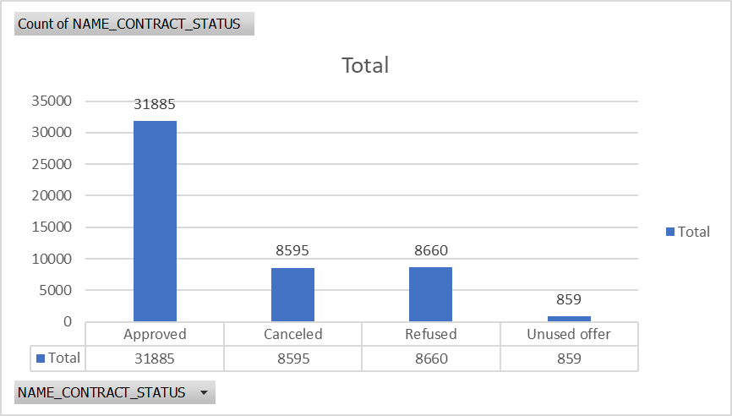
Previous Application dataset
Univariate Analysis
Row Labels | Count of NAME_CONTRACT_STATUS
Approved | 31885
Canceled | 8595
Refused | 8660
Unused offer | 859
Grand Total | 49999

Slide 44
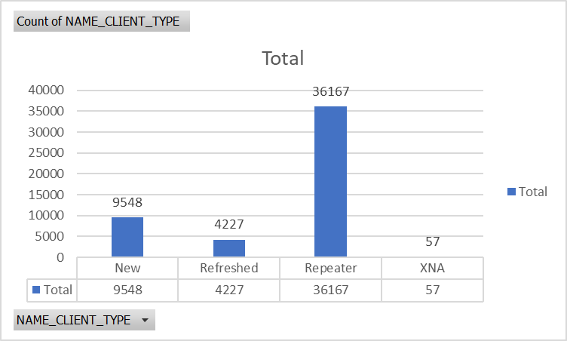
Univariate Analysis
Row Labels | Count of NAME_CLIENT_TYPE
New | 9548
Refreshed | 4227
Repeater | 36167
XNA | 57
Grand Total | 49999

Slide 45
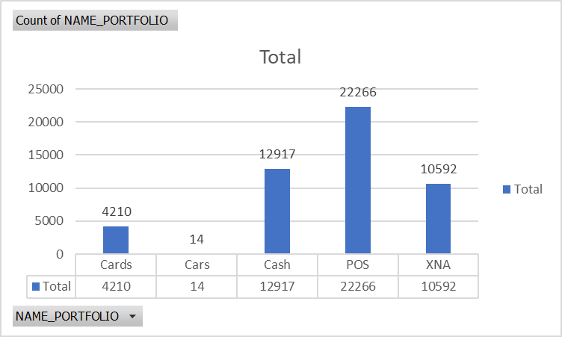
Univariate Analysis
Row Labels | Count of NAME_PORTFOLIO
Cards | 4210
Cars | 14
Cash | 12917
POS | 22266
XNA | 10592
Grand Total | 49999

Slide 46
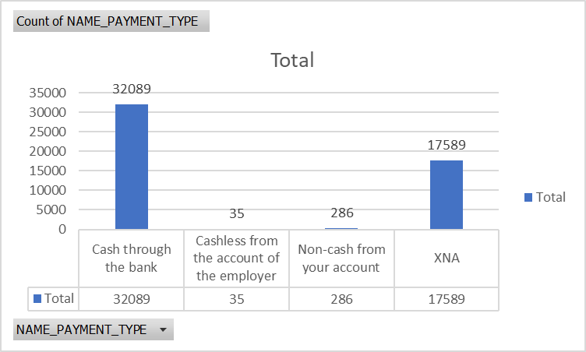
Univariate Analysis
Row Labels | Count of NAME_PAYMENT_TYPE
Cash through the bank | 32089
Cashless from the account of the employer | 35
Non-cash from your account | 286
XNA | 17589
Grand Total | 49999

Slide 47
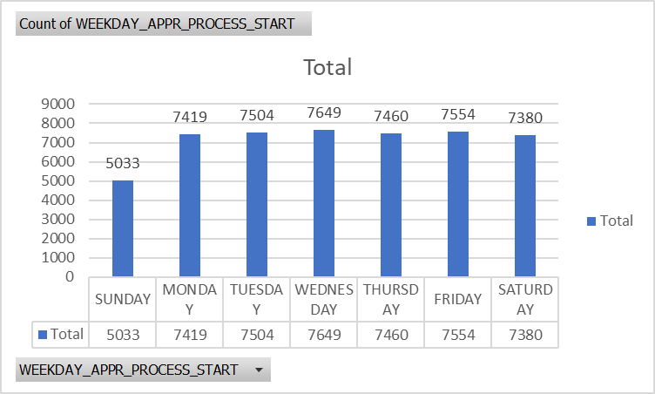
Univariate Analysis
Row Labels | Count of WEEKDAY_APPR_PROCESS_START
SUNDAY | 5033
MONDAY | 7419
TUESDAY | 7504
WEDNESDAY | 7649
THURSDAY | 7460
FRIDAY | 7554
SATURDAY | 7380
Grand Total | 49999

Slide 48
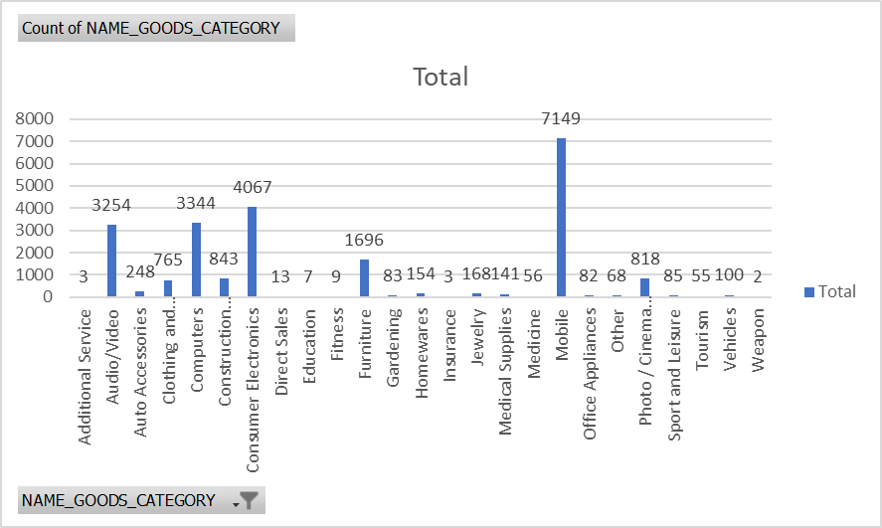
Univariate Analysis
Row Labels | Count of NAME_GOODS_CATEGORY
Additional Service | 3
Audio/Video | 3254
Auto Accessories | 248
Clothing and Accessories | 765
Computers | 3344
Construction Materials | 843
Consumer Electronics | 4067
Direct Sales | 13
Education | 7
Fitness | 9
Furniture | 1696
Gardening | 83
Homewares | 154
Insurance | 3
Jewelry | 168
Medical Supplies | 141
Medicine | 56
Mobile | 7149
Office Appliances | 82
Other | 68
Photo / Cinema Equipment | 818
Sport and Leisure | 85
Tourism | 55
Vehicles | 100
Weapon | 2
Grand Total | 23213

Slide 49
Data Analytics task 5
Identify Top Correlations for Different Scenarios: Understanding the correlation between variables and the target variable can provide insights into strong indicators of loan default.
Task: Segment the dataset based on different scenarios (e.g., clients with payment difficulties and all other cases) and identify the top correlations for each segmented data using Excel functions.

Slide 50
Understanding Correlation
Correlation analysis is a statistical method used to evaluate the strength and direction of the relationship between two or more variables. The correlation coefficient ranges from -1 to 1.
A correlation coefficient of 1 indicates a perfect positive correlation. This means that as one variable increases, the other variable also increases.
A correlation coefficient of -1 indicates a perfect negative correlation. This means that as one variable increases, the other variable decreases.
A correlation coefficient of 0 means that there’s no linear relationship between the two variables.

Slide 51
For a correlation table, first we need to select the target variable. Here our target variable is TARGET as seen from the dataset. Now we correlate TARGET with every possible field.
But there is one limitation, we cant correlate them with the field having
Non numeric values.
Thus we have correlated them with the ones having
Numeric values.
Following is the formula we used (We kept the
TARGET field as constant array1 to provided in formulas of
CORREL for every other field except TARGET itself.

Slide 52
 | TARGET | CNT_CHILDREN | AMT_INCOME_TOTAL | AMT_CREDIT | AMT_ANNUITY | AMT_GOODS_PRICE | REGION_POPULATION_RELATIVE | DAYS_EMPLOYED | DAYS_REGISTRATION
TARGET | 1
CNT_CHILDREN | 0.026363931 | 1
AMT_INCOME_TOTAL | 0.010893745 | 0.009588558 | 1
AMT_CREDIT | -0.032428347 | 0.00497156 | 0.069315897 | 1
AMT_ANNUITY | -0.011774584 | 0.02724566 | 0.08074804 | 0.769153894 | 1
AMT_GOODS_PRICE | -0.041306523 | 0.000253361 | 0.069885575 | 0.98694373 | 0.774021996 | 1
REGION_POPULATION_RELATIVE | -0.040799172 | -0.025555665 | 0.029841469 | 0.095111221 | 0.113252592 | 0.099190323 | 1
DAYS_EMPLOYED | -0.040294905 | -0.239693041 | -0.031615555 | -0.070471393 | -0.110536269 | -0.067845372 | -0.004101686 | 1
DAYS_REGISTRATION | 0.042342679 | 0.181217183 | 0.009952379 | 0.003448569 | 0.035447688 | 0.006101039 | -0.059322344 | -0.204680611 | 1
Application dataset

Slide 53
 | AMT_ANNUITY | AMT_APPLICATION | AMT_CREDIT | AMT_GOODS_PRICE | HOUR_APPR_PROCESS_START | DAYS_DECISION | SELLERPLACE_AREA
AMT_ANNUITY | 1
AMT_APPLICATION | 0.835099562 | 1
AMT_CREDIT | 0.82776803 | 0.993678 | 1
AMT_GOODS_PRICE | 0.835099562 | 1 | 0.993678 | 1
HOUR_APPR_PROCESS_START | -0.040051964 | -0.051362256 | -0.059106507 | -0.051362256 | 1
DAYS_DECISION | 0.236470442 | 0.247155032 | 0.254453359 | 0.247155032 | 0.008044933 | 1
SELLERPLACE_AREA | -0.009153003 | -0.006637495 | -0.006977925 | -0.006637495 | 0.017294746 | -0.00222983 | 1
Previous Application dataset

Slide 54
Conclusion
The bank needs to address outliers and payment difficulties to minimize risks associated with defaulting clients.
The imbalanced dataset necessitates the use of appropriate techniques to handle class imbalance during modeling.
The bank's preference for granting loans to comparatively senior clients seems reasonable due to potential stability in financial backgrounds, resulting in the chart.
Clients with limited employment experience may require closer scrutiny during loan approval.
Further action is needed to understand why male clients show slightly higher default rates when compared with the total number of loans taken.
Focusing on clients with secondary education might be beneficial as they form the largest customer segment.

Slide 55
Achievement
Gained deeper knowledge on working with pivot tables
How we can identify outliers in the dataset and how important they are to identify
Studying data imbalance in the dataset as they will result in the inaccuracy of our analysis
How to draw chart based on different scenarios and pivot tables
Finding the correlation between different variables.
Why data cleaning is most important step in analysis a particular dataset.
Used different formulas to find output.

Slide 56
Thank You
Ayush Yadav

